Slide 1
VergeSense Installation
VS-E106 overview
David Whiley
V3.0 March 2025

Slide 2
Agenda
01
02
03
04
05
06
07
Introduction
Hardware
Installer tool
Process Overview
Installation Steps
Team Structure and Deployment Timeline
Q&A

Slide 3

Introductions
David Whiley
Implementation Specialist

Slide 4
Hardware

Slide 5
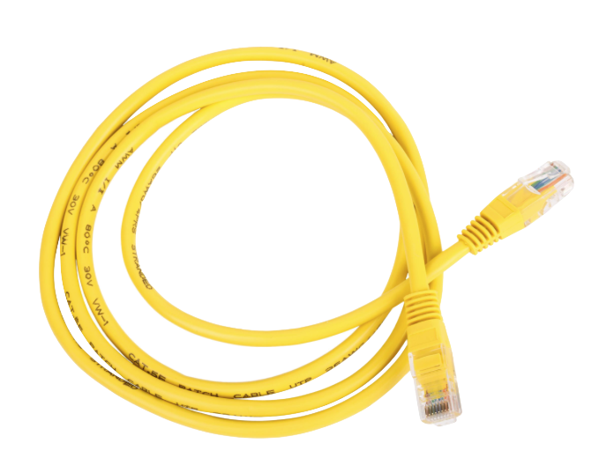
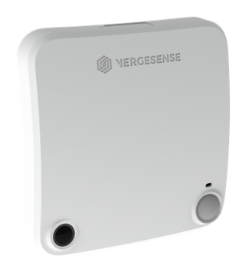
What is being installed?
VS-E106
Size:
3.8” (98mm) (L)
3.8” 98 mm (W)
1.1” (28 mm) (H)
Cat 5/6
1 per device

Slide 6
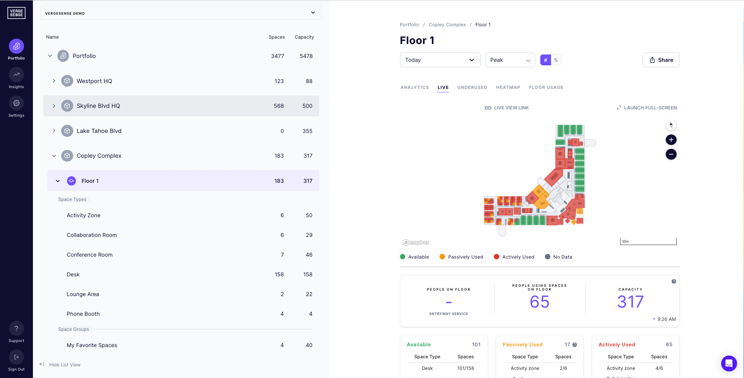
How it connects
Corporate Network

Slide 7
Installer tool

Slide 8

Installer tool
The VergeSense Installer Tool application can be used to:
Advises where the hardware is to be installed
Check Sensor connectivity
Confirm sensor coverage
Track installation progress
VergeSense will grant access to the installer tool prior to start of installation.
Access the web based application at
cloud.vergesense.com

Slide 9
Process Overview

Slide 10
Installation Process Overview
Installation Team
VergeSense
Install
Sensors
Confirm Connectivity
& Coverage
VergeSense Implementation Support
Remotely / Onsite

Slide 11
Installation Process Overview
VergeSense (Small installations)
VergeSense will review & flag sensors
Reporting back to the installation team the SAME DAY for adjustment
VergeSense (Larger installations)
VergeSense will review & flag sensors
Reporting back to the installation team a report for Go Back remedial works

Slide 12
Installation Process Overview
Installation Team
VergeSense
Review flagged
Sensors
Adjust Sensors &
Clear flags
(Adding notes if required)
Confirm Connectivity
& Coverage
VergeSense Implementation Support
Remotely / Onsite

Slide 13
Installation order - #1
Physical installation
Run cabling for sensor. Leave some slack for adjustments of sensor location if needed.
Use VergeSense Installer tool
To check the location of where the sensor is to be installed.

Slide 14
Installation order - #2
Physical installation of sensors
Install sensor as per the Installer tool floor plan
Install in the orientation shown (Arrow)
Power on
Use VergeSense Installer tool to:
Enter ID of sensor
Check Connectivity
Confirm coverage
Publish sensor

Slide 15
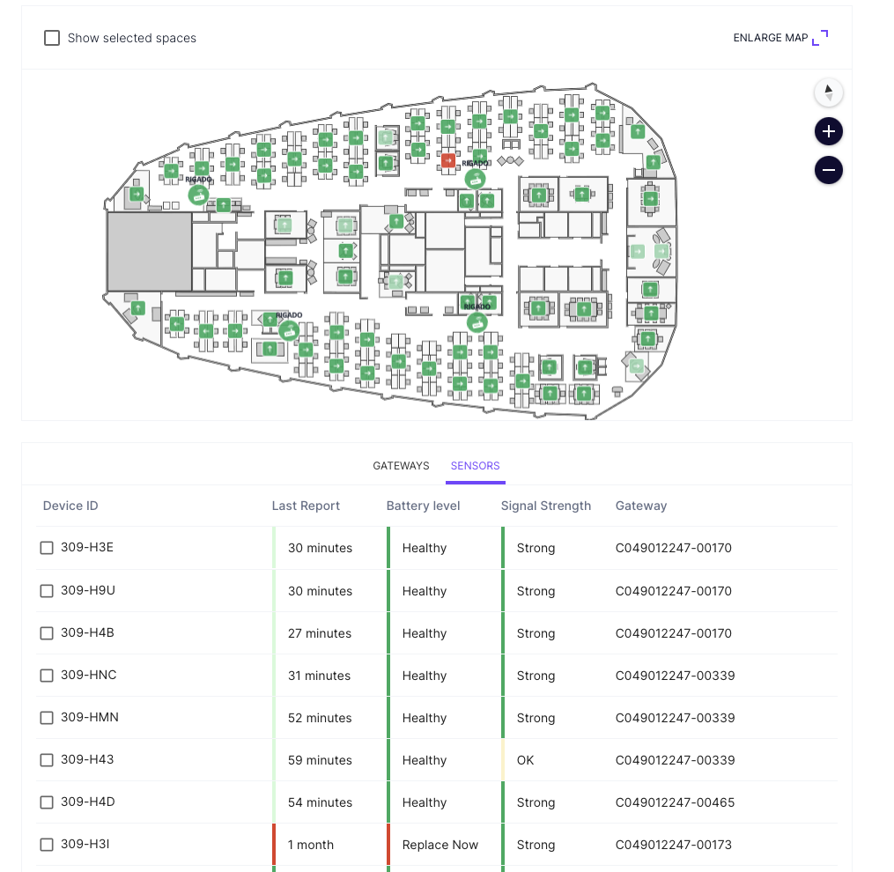
Installation order - #3
Check connectivity
Navigate to the System Health Page
Review status of all Sensors
Troubleshoot if needed

Slide 16
Installation Steps

Slide 17
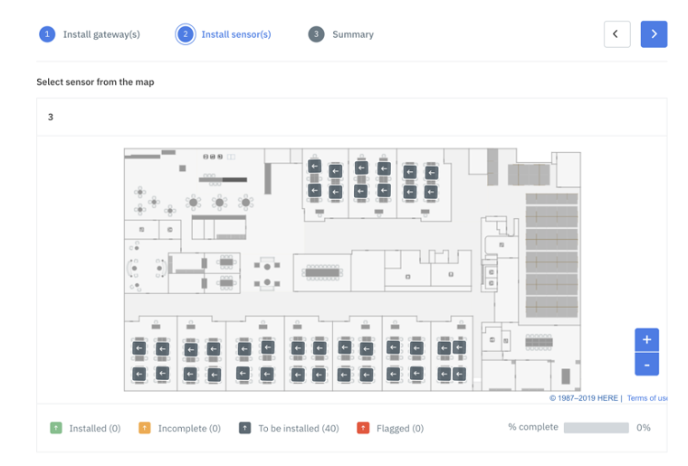
Sensor Installation
Locate where the sensor needs to be installed
Open the installer tool
Select the floor of installation
On the second step, you are presented with all the sensor icons of where they are to be installed (grey)

Slide 18
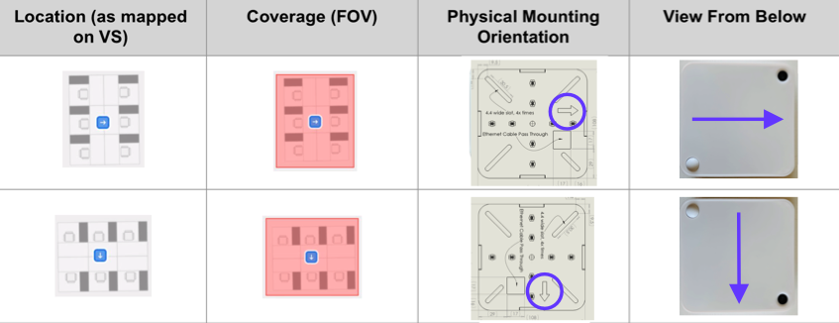
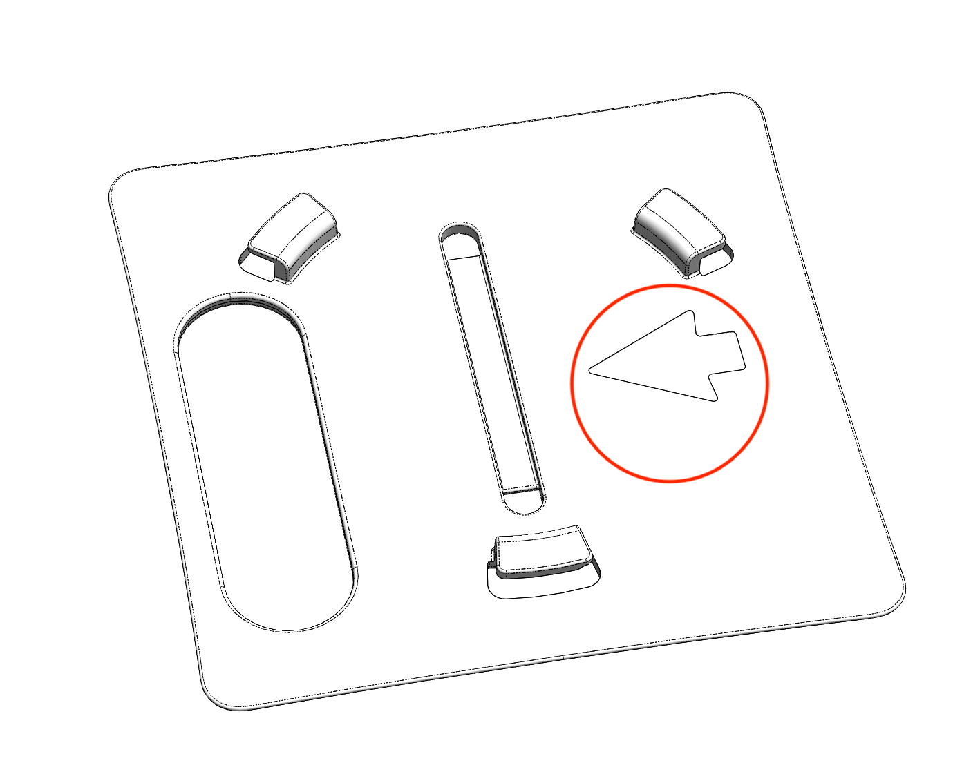
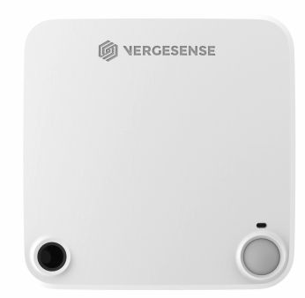
Sensor Installation
Orientation
Position the sensor to match the orientation indicated on the installation map

Slide 19
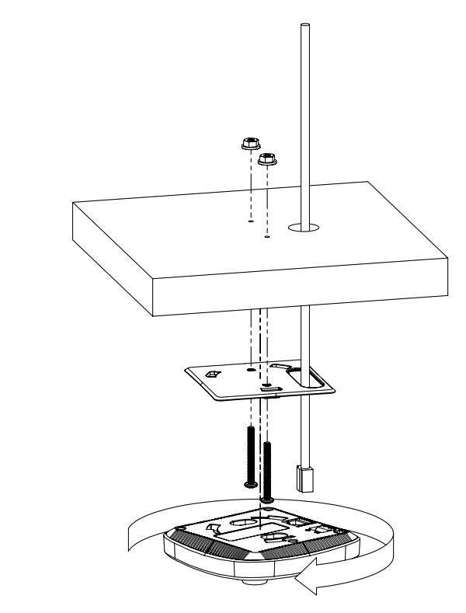
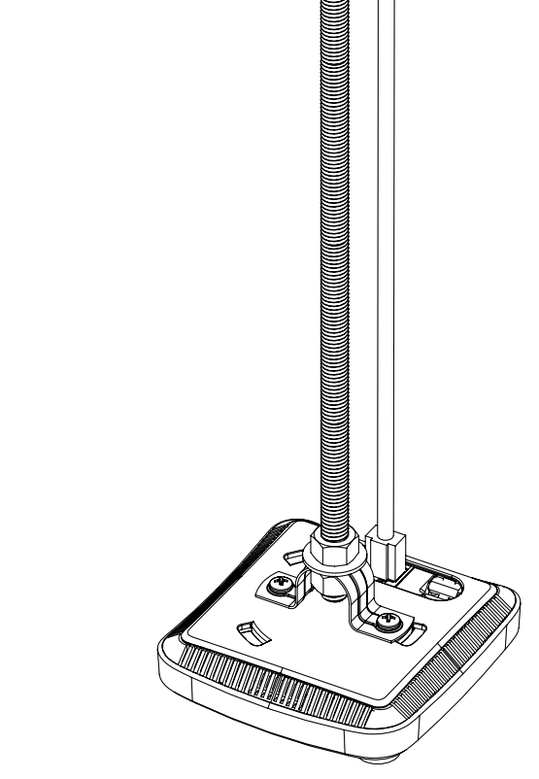
Sensor Installation
Mounted installtion Threaded rod/conduit installation

Slide 20
Sensor Installation
Physical installation of sensors
Power the sensor by inserting the POE cable into sensor.
The sensor will automatically power on.
When first booting up, the sensor will cycle - Red, Green, Blue (0.5s each color) 3 times
Note: there is no OFF position. Remove batteries to power off.
Sensor ID is on the side

Slide 21
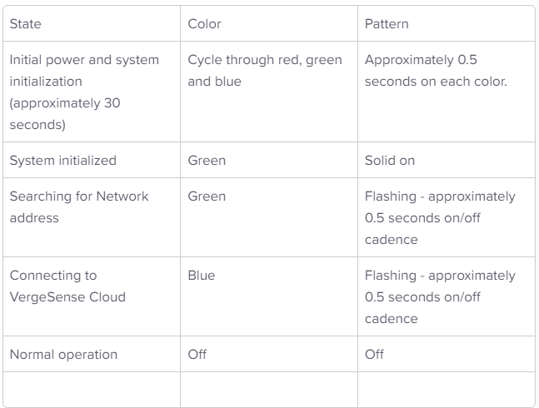
Sensor Installation – LED Patterns

Slide 22
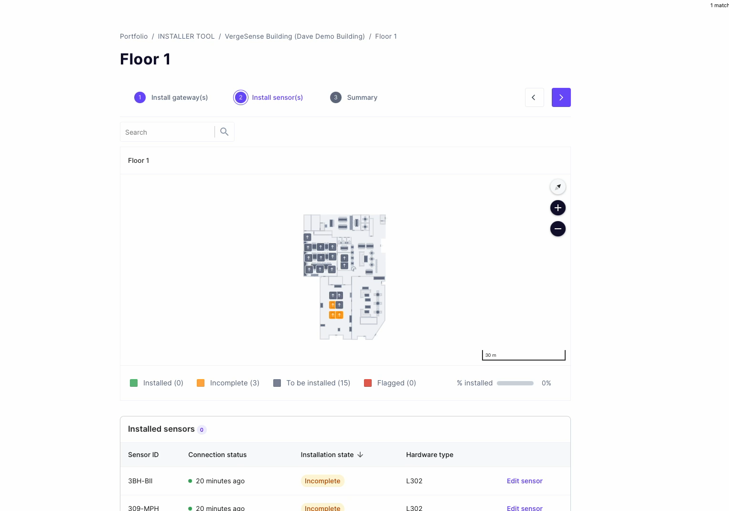
Sensor Installation
Enter the sensor ID into the installer tool

Slide 23
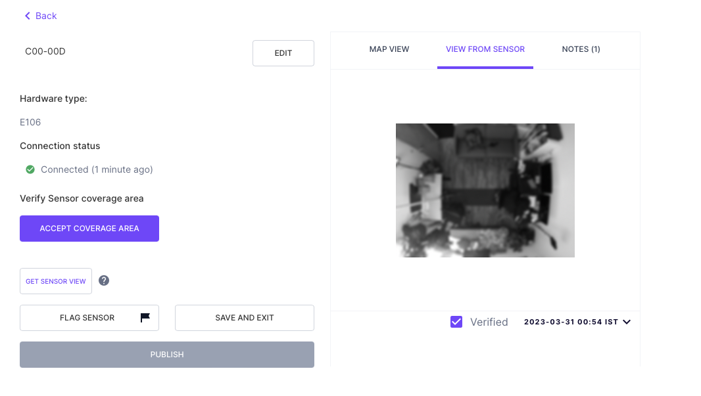
Sensor Installation
Confirming coverage
It may a few minutes after first connecting for the sensor debug image to update.
New images can be requested through the “Get Sensor View” button.
Debug file will also depend on how many sensors are already online in the mesh. The more are online, the faster they will connect.

Slide 24
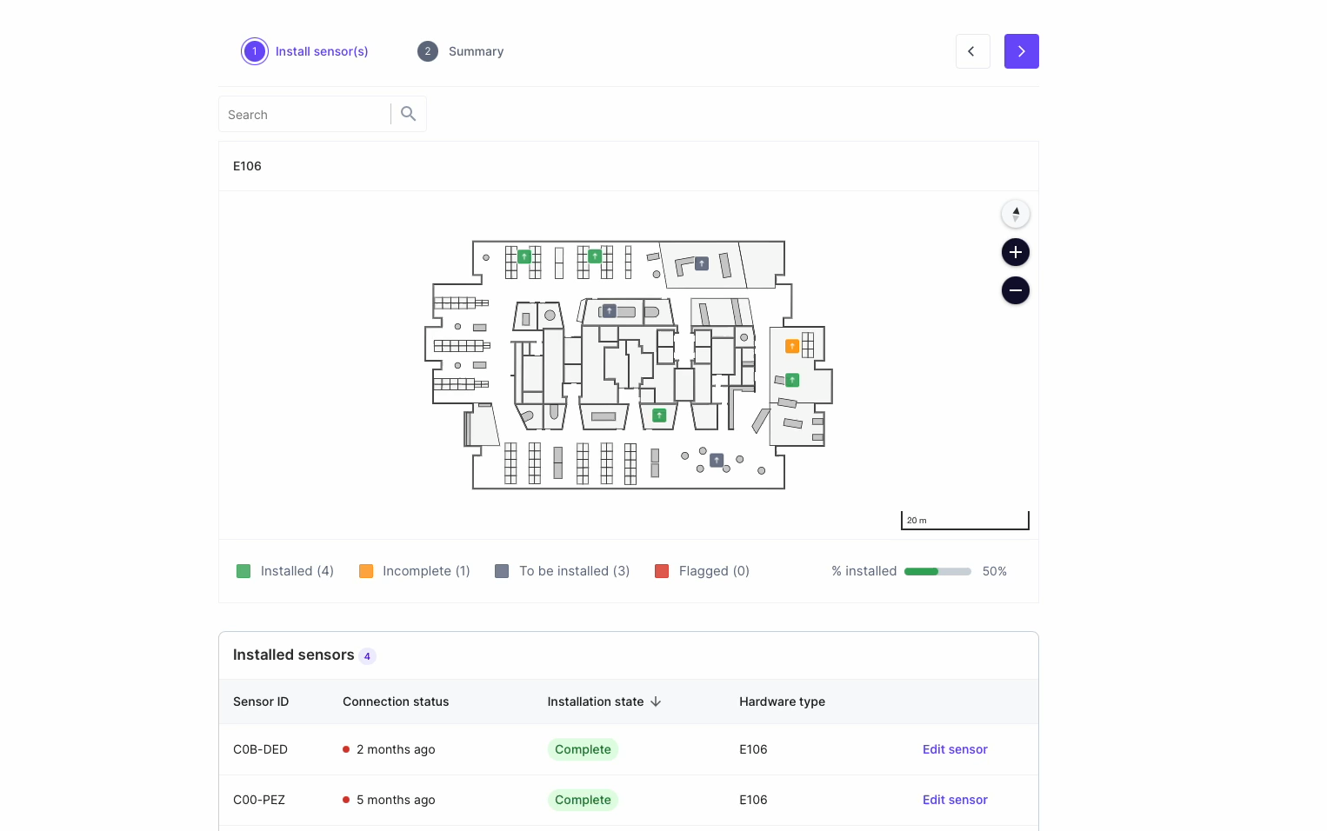
Sensor Installation
Confirming coverage
View coverage
Accept coverage
Publish sensor.
If coverage is not acceptable:
Adjust sensor
Request new image
Accept/Publish sensor

Slide 25
Sensor Installation - Tips
Best Practice
Do not block sensor with your hand or body
You can power cycle by holding the removing and re-inserting the POE cable.
You can also request a new debug image from the installer tool by clicking the button Get sensor view

Slide 26
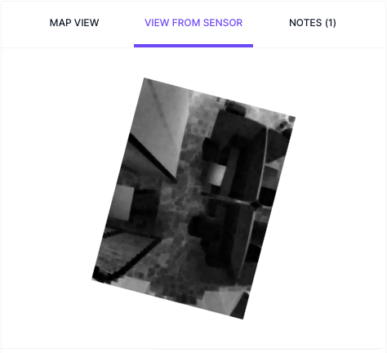
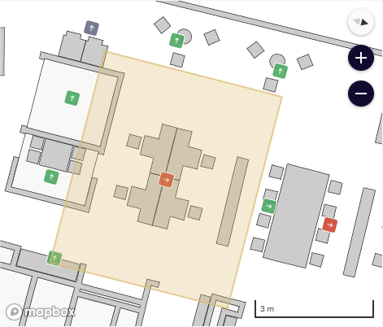
Sensor Installation – common mistakes

Slide 27
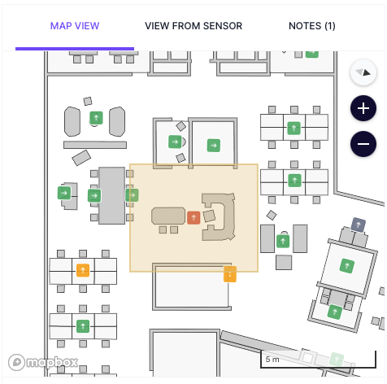
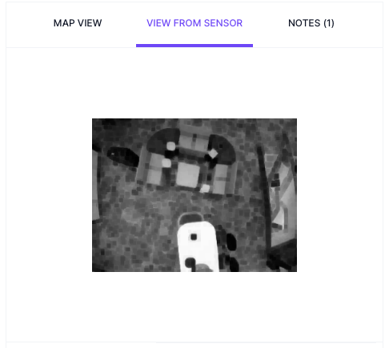
Sensor Installation – common mistakes

Slide 28
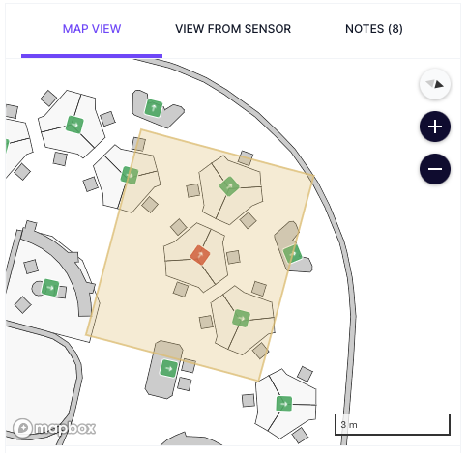
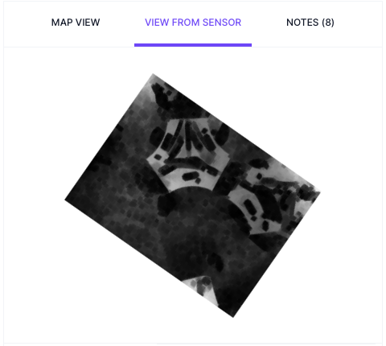
Sensor Installation – common mistakes

Slide 29
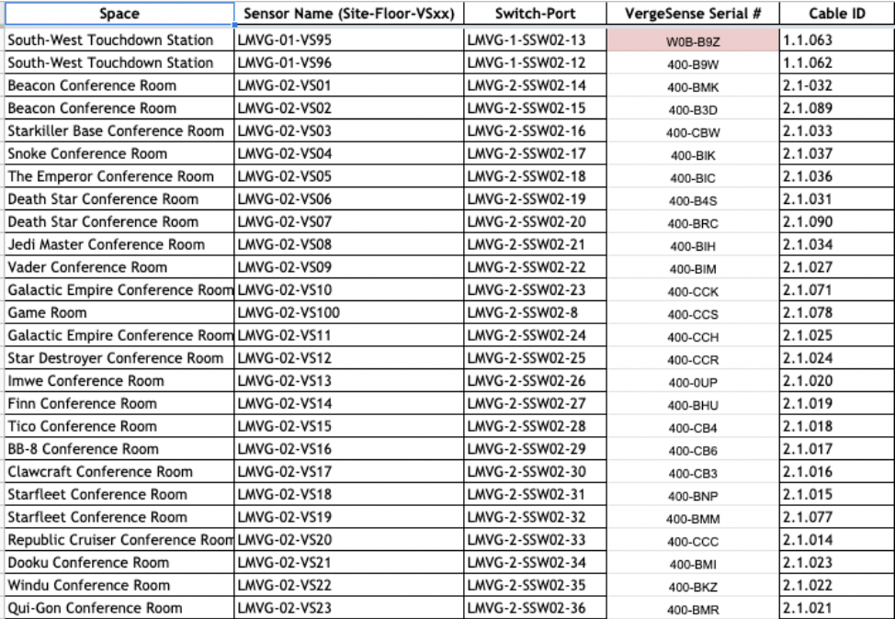
Sensor Installation – As-Built Matrix
Best Practice
Site
Floor
Space Name
Sensor Name (if applicable)
Switch
Port
Cable ID
VerseSense Sensor ID

Slide 30
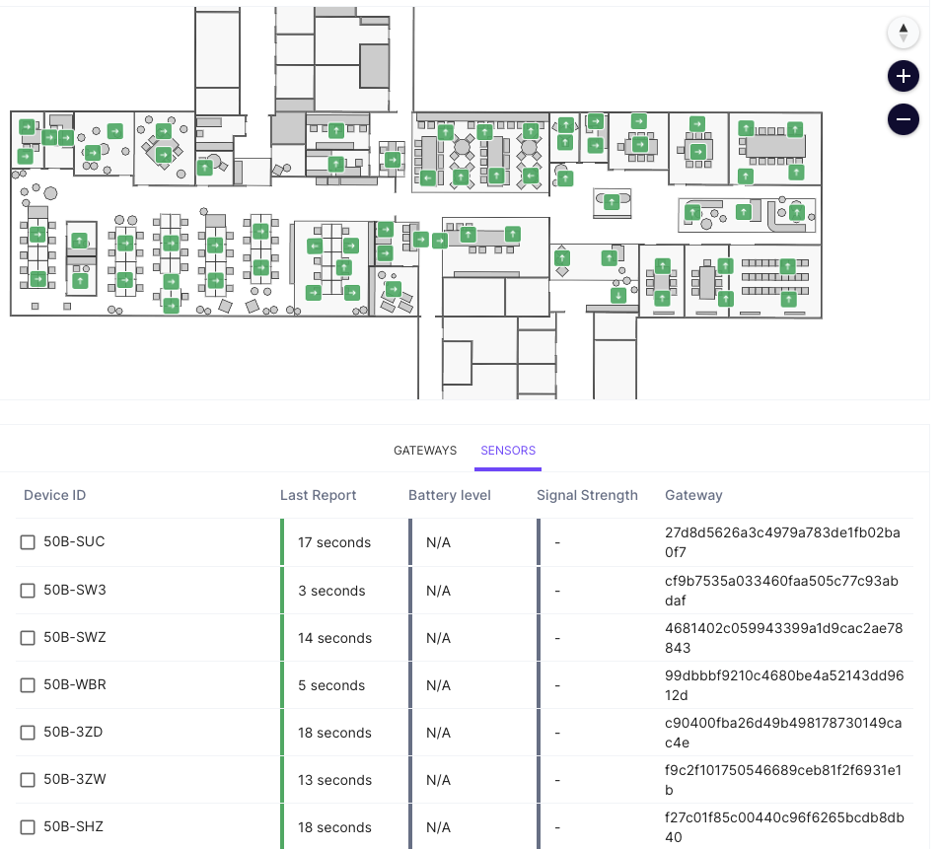
Sensor Installation – System Health
The System Health page gives a status overview of all Sensors.
including the following information:
Sensors
  Device ID
  Last Report timestamp

Slide 31
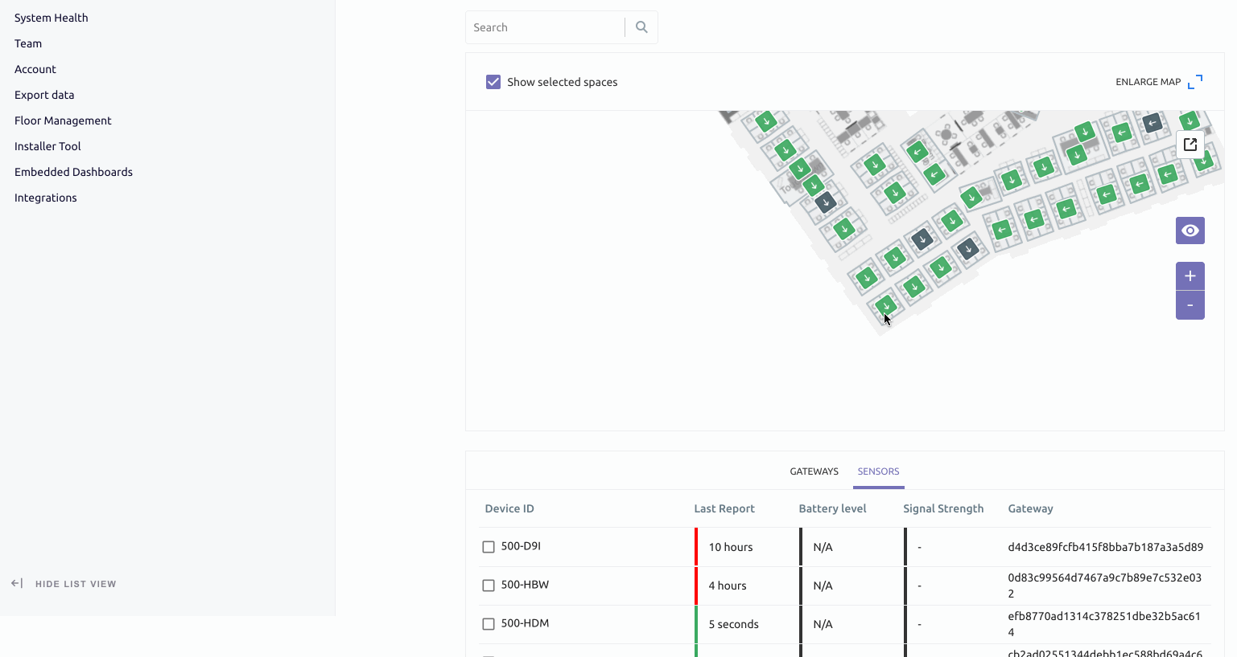
Sensor Installation – System Health
After all devices have been installed on a floor, navigate to the System Health page.
Green = Good
Red/Yellow = Needs attention (e.g. disconnected)
Black = Never connected (verify ID/power)

Slide 32
Installation - Troubleshooting
If sensor does not connect
Confirm ID
Confirm power
Power cycle
Replace sensor
If still not connecting, contact VergeSense support

Slide 33
Team Structure and
Deployment Timeline

Slide 34
Team Structure and Deployment Timeline
Two person team
Three person team
Each Tech
Ceiling Installation
Check coverage and make adjustments
Checkout
(Cleanup, etc)
Setup
Pre-place sensor at ground level, enter sensor IDs
Ceiling Installation
(if time)
Check coverage and make adjustments
Tech 1
(Lead)
Ceiling Installation
(on ladder)
Tech 2 & 3
Setup
Checkout (Cleanup, etc)

Slide 35
Team Structure and Deployment Timeline
1 hour
Setup
6 hours
Installation
(30 sensors)
1 hour
Cleanup
Coverage
Check
Send
Summary

Slide 36

Live Support
VergeSense will be available to support live.
Preferred method of communication is WhatsApp.
Please share contact info to setup a group chat.

Slide 37
Questions?

Slide 38
Thank you

