Slide 1
VergeSense Installation
VS-L302 overview
David Whiley
V3.1 May 2025 (G400C G400NC)

Slide 2
Agenda
01
02
03
04
05
06
07
Introduction
Hardware
Installer tool
Process Overview
Installation Steps
Team Structure and Deployment Timeline
Q&A

Slide 3

Introductions
David Whiley
Senior Implementation Specialist

Slide 4
Hardware

Slide 5
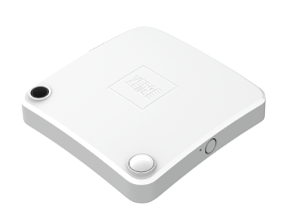
What is being installed?
VS-L302 Area Sensor
Size:
4.6” (117mm) (L)
3.3” 84 mm (W)
1.3” (34 mm) (H)

Slide 6
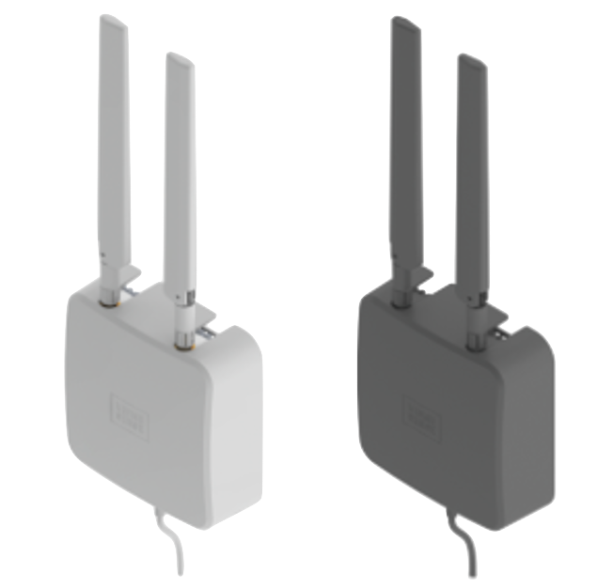
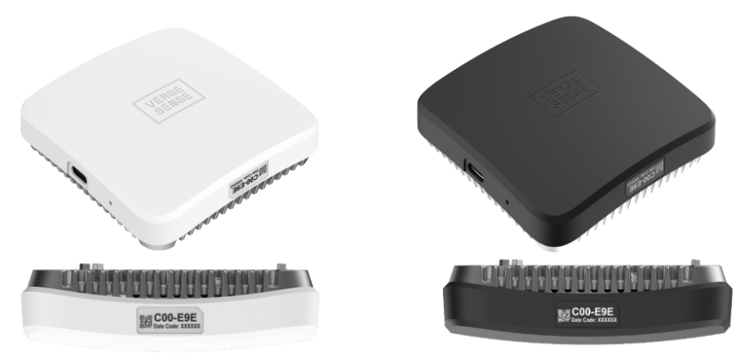
What is being installed?
G400 Gateway (Cellular)
Size:
1.65” (42mm) (D)
4.05” (103 mm (W)
12.80” (325 mm) (H)
G400 Gateway (Non-Cellular)
Size:
3.8” (98mm) (L)
3.8” 98 mm (W)
1.1” (28 mm) (H)

Slide 7
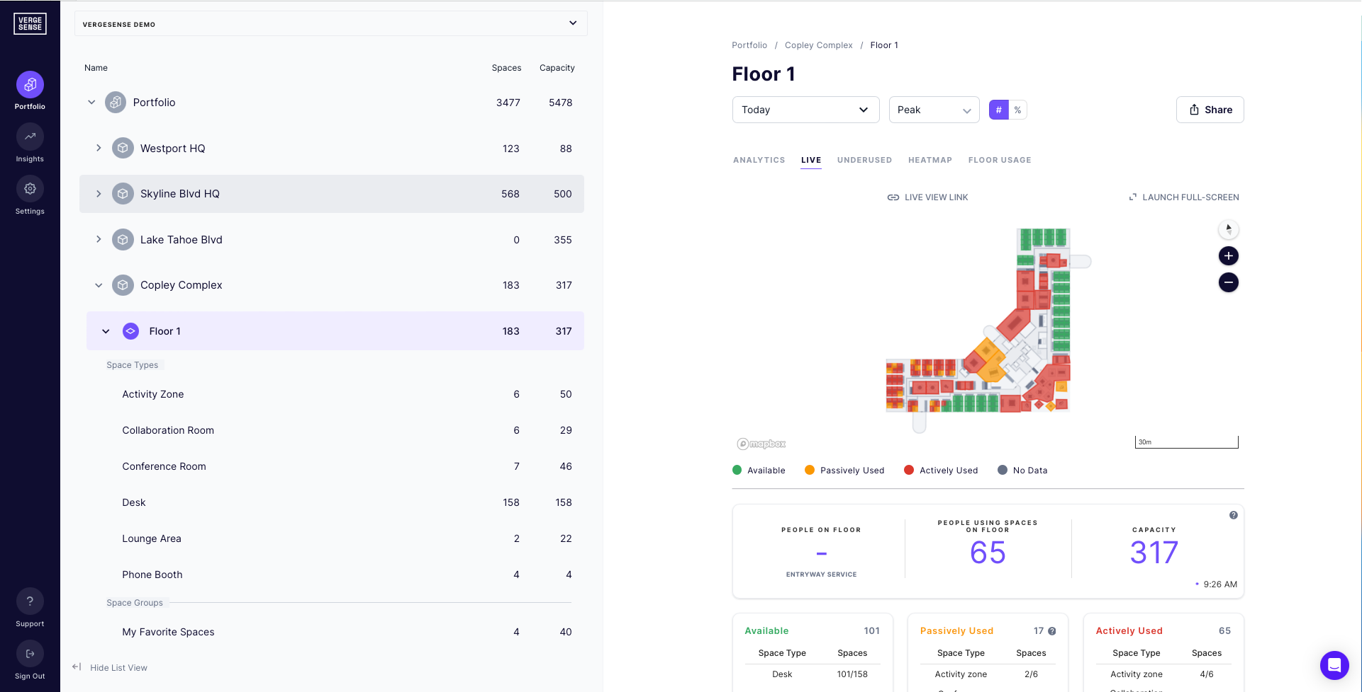
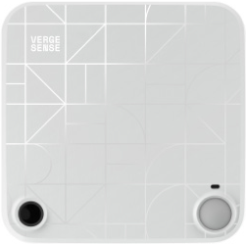
How it connects
Corporate network
WiFi / Ethernet

Slide 8
How it connects
VergeSense VS-L302 sensors generate their own wireless network
The mesh network configures itself up to make the deployment of devices simple and ensures the most stable wireless connectivity.
The network will not be visible to WiFi or Bluetooth enabled devices.

Slide 9
Installer tool

Slide 10
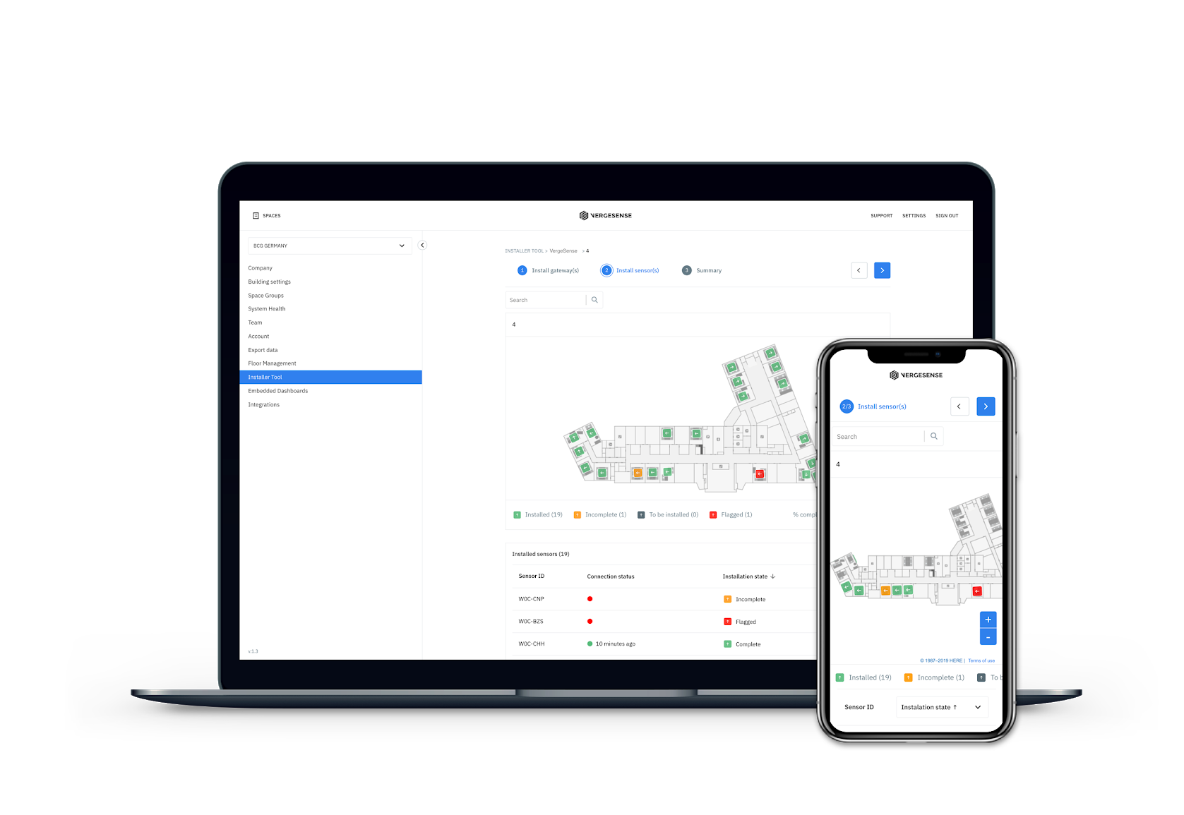
Installer tool
The VergeSense Installer Tool application can be used to:
Advises where the hardware is to be installed
Check gateway and sensor connectivity
Confirm sensor coverage
Track installation progress
VergeSense will grant access to the installer tool prior to start of installation.
Access the web based application at
cloud.vergesense.com

Slide 11
Process Overview

Slide 12
Installation Process Overview
Installation Team
VergeSense
Install
Gateways
Install
Sensors
Confirm Connectivity
& Coverage
VergeSense Implementation Support
Remotely / Onsite

Slide 13
Installation Process Overview
VergeSense (Small installations)
VergeSense will review & flag sensors
Reporting back to the installation team the SAME DAY for adjustment
VergeSense (Larger installations)
VergeSense will review & flag sensors
Reporting back to the installation team a report for Go Back remedial works

Slide 14
Installation Process Overview
Installation Team
VergeSense
Review flagged
Sensors
Adjust Sensors &
Clear flags
(Adding notes if required)
Confirm Connectivity
& Coverage
VergeSense Implementation Support
Remotely / Onsite

Slide 15
Installation order - #1
Physical installation
All gateways need to be installed for floor
Use VergeSense Installer tool
Enter ID of gateway
Check Connectivity

Slide 16
Installation order - #2
Physical installation of sensors
Locate sensor on map
Match orientation to map
Power on
Use VergeSense Installer tool to:
Enter ID of sensor
Check Connectivity
Check and accept coverage
Publish sensor

Slide 17
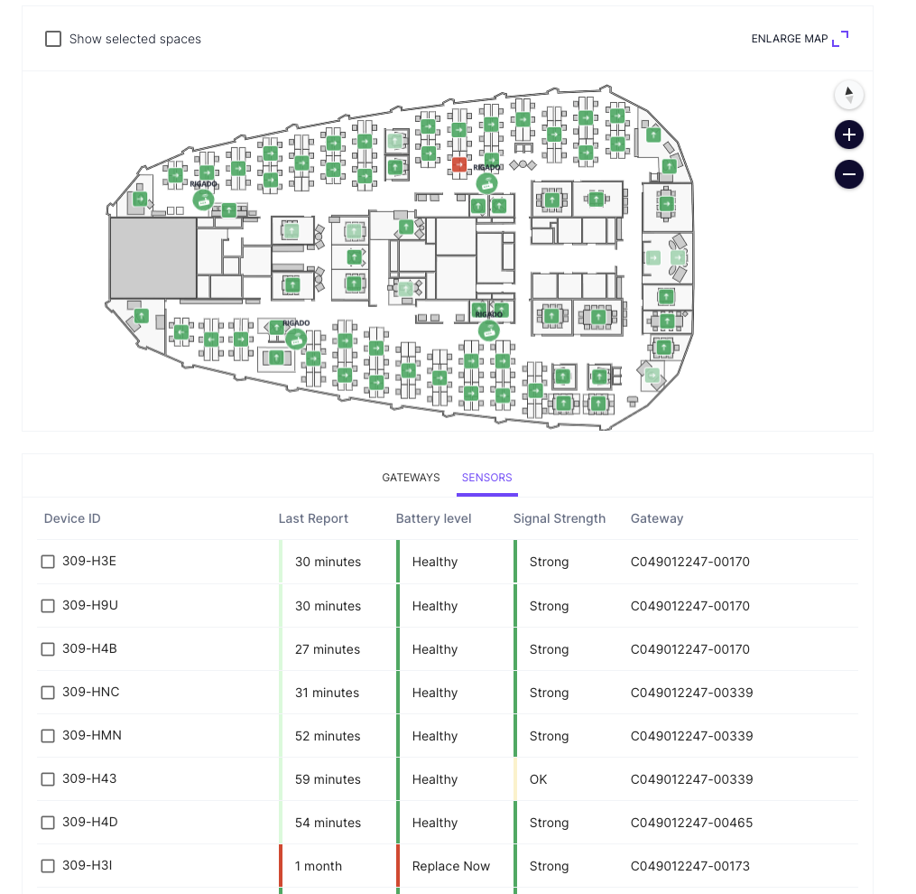
Installation order - #3
Check connectivity
Navigate to the System Health Page
Review status of all sensors/gateways
Troubleshoot if needed

Slide 18
Installation Steps

Slide 19
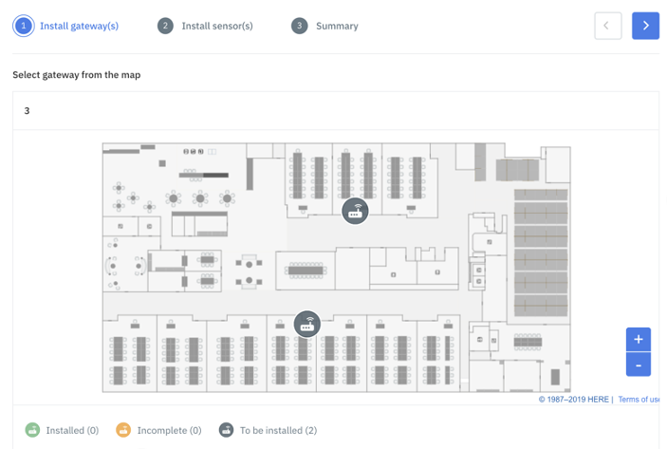
Gateway Installation
Locate where the gateway needs to be installed
Open the installer tool
Select the floor of installation
On the first step, you are presented with all the gateway locations

Slide 20
Gateway Installation
Install Antennas
Special consideration should be given to any metal near the mounting area, such as in support beams or HVAC ducts. Mount away from shelves, cabinets, HVAC ducts, and other obstacles
For optimal range, it is best to install gateway facing towards coverage area. Maintain clear line of sight or minimize obstacles to desired coverage areas.
Load Wifi credentials (if required) via USB key provided

Slide 21
Gateway Installation
Power can be delivered through PoE.
Check Connectivity
START UP PROCEDURE
Time | Device Status | LED State
0 | No power to the device | All off
0 - 10s | Start up | All off
10s-15s | Start up | All on solid (white/yellow color)
15s-20s | Start up | Red and blue on solid (purple color)
20s -30s | Power on self test | Green on solid (green color)
30s+ | Hardware failure detected | Red 500msec on-off cadence
DEVICE IS NOW ON
Time | Device Status | LED State
30s+ | Devices tries to connect to the local network | Green 500msec on-off cadence
30s+ | Device is connected to the local network and attempting to connect to VS cloud | Blue 500 msec on-off cadence
30s+ | Indicate normal operation | All Off
 | Factory Reset | Blue on solid for 5-30s after release of reset button, then all off when reset is complete
 | USB stick inserted | Blue on solid for 5-60s after insertion of USB stick, then all off when it’s safe to remove the USB stick

Slide 22
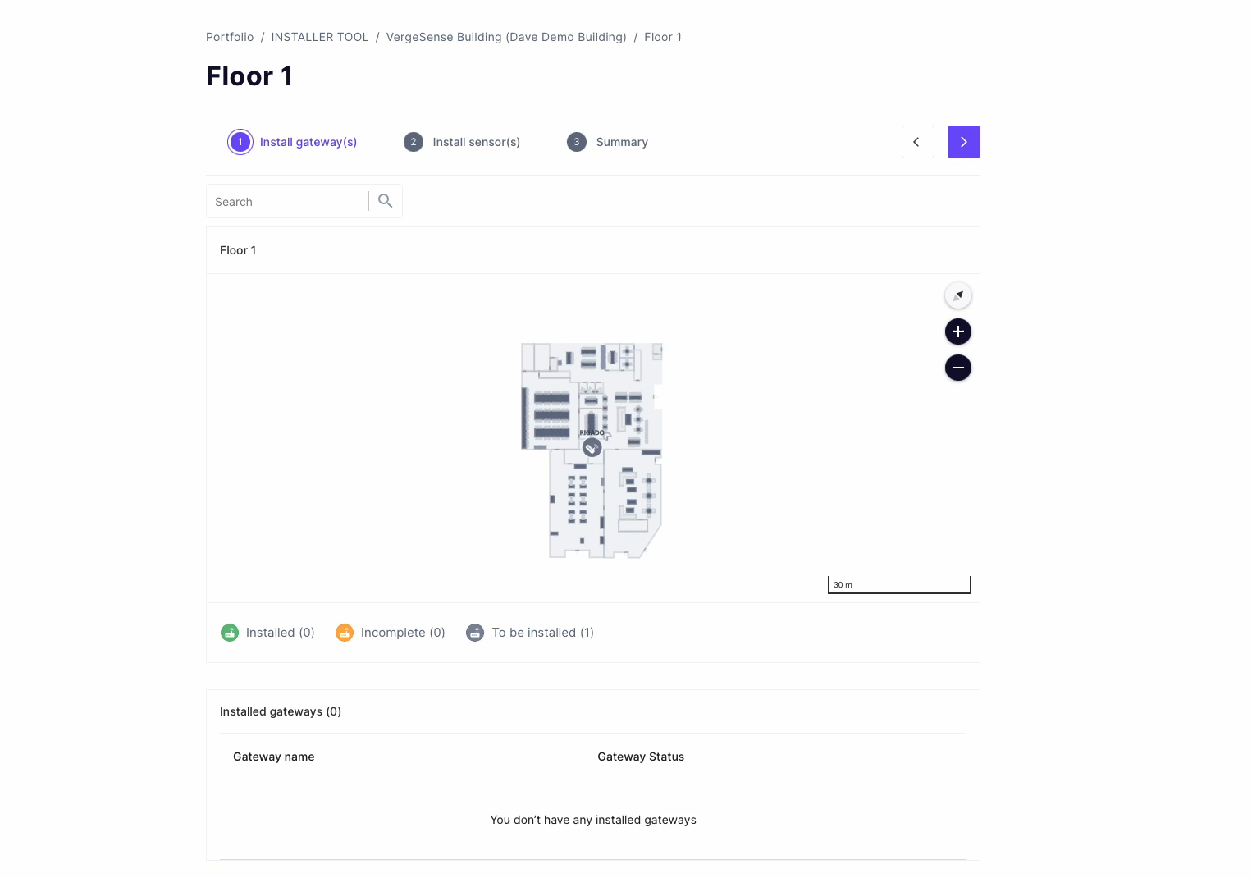
Gateway Installation
Enter the ID of the Gateway
ID is located on the gateway itself.
Once connected, confirm timestamp is recent

Slide 23
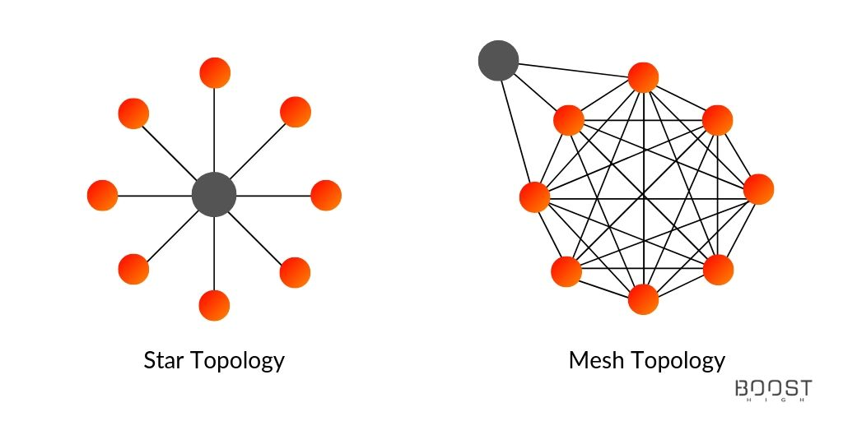
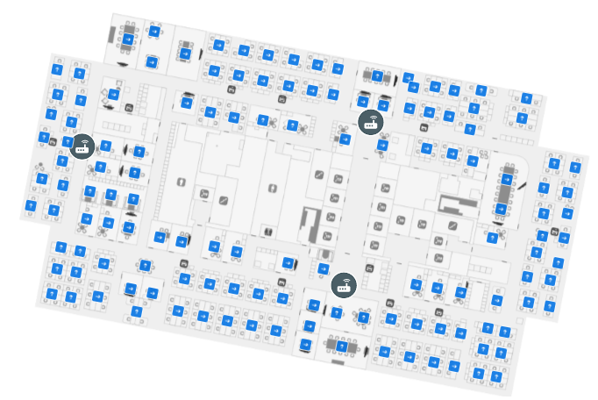
Sensor Installation
Mesh network
Always begin with the sensors nearest the gateway. The sensors will connect to each other to create a mesh network.
The more sensors are installed, the faster they may connect.
Maximum distance from sensor and gateway is 40’
Maximum distance from sensor to sensor is 40’

Slide 24
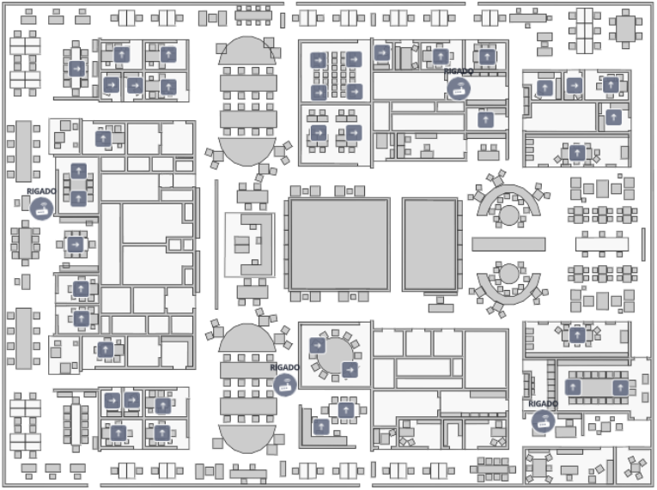

Sensor Installation
Confirming coverage
View coverage
Accept coverage
Publish sensor.
If coverage is not acceptable:
Adjust sensor
Reboot sensor
Accept/Publish sensor

Slide 25
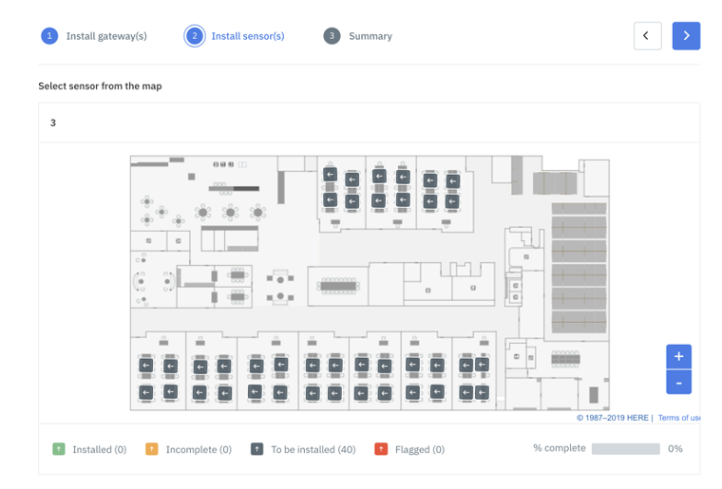
Sensor Installation
Locate where the sensor needs to be installed
Open the installer tool
Select the floor of installation
On the second step, you are presented with all the sensor icons of where they are to be installed (grey)

Slide 26
Sensor Installation
Physical installation of sensors
Power the sensor by removing the purple battery tab.
The sensor will automatically power on.
When first booting up, the sensor will cycle - Red, Green, Blue (0.5s each color) 3 times
The light will flash green once every 15s for 5min confirming connectivity.
Note: there is no OFF position. Remove batteries to power off.
Sensor ID is on the side

Slide 27
Sensor Installation
LED patterns
GREEN – CONNECTION CONFRIMED
Flashing (0.5s) once every 15s for 5 min
RED – NO CONNECTION
Flashing (0.5s) once every 15s for 5 min
BLUE – HARDWARE FAILURE
Flashing

Slide 28
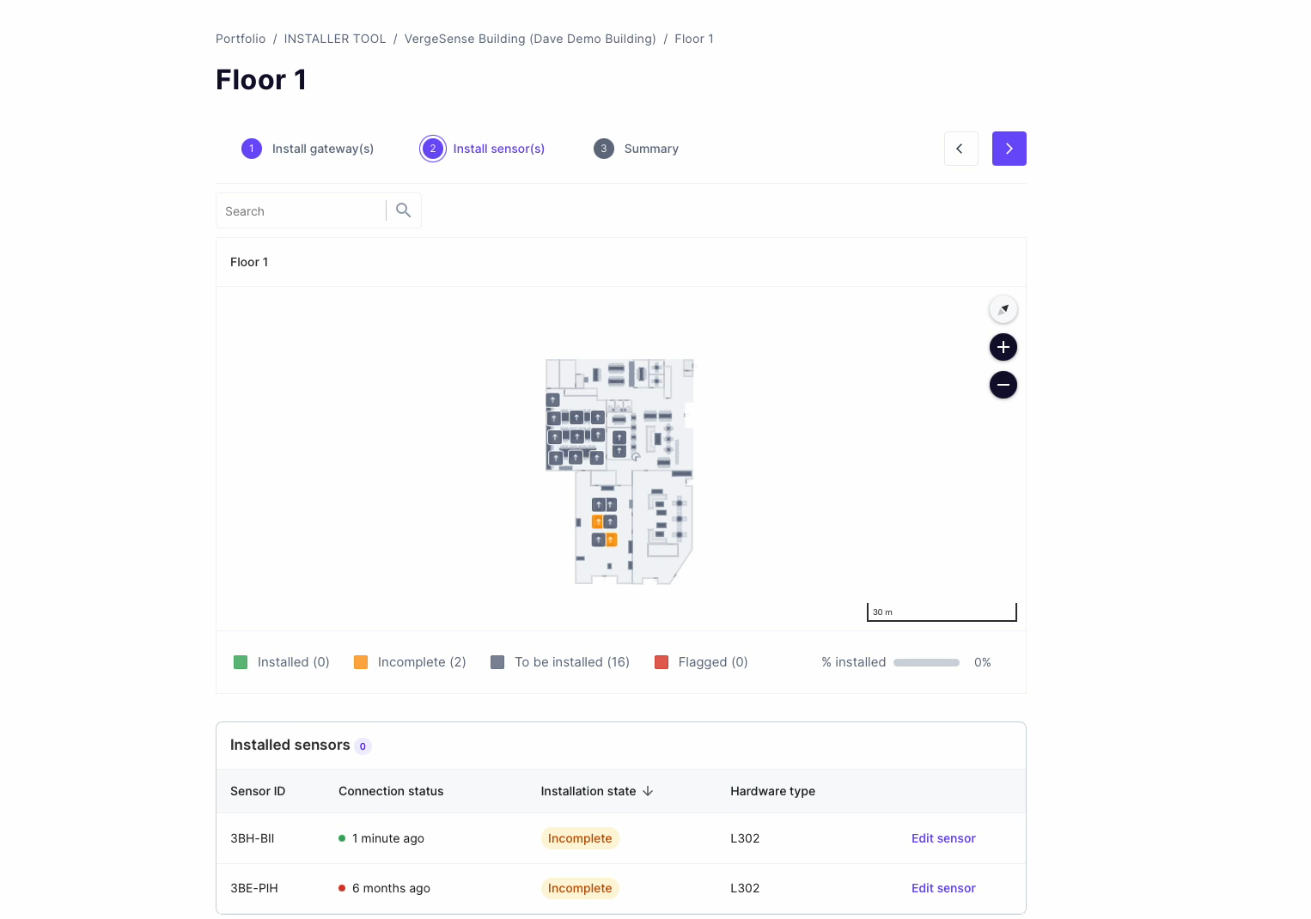
Sensor Installation
Enter the sensor ID into the installer tool

Slide 29
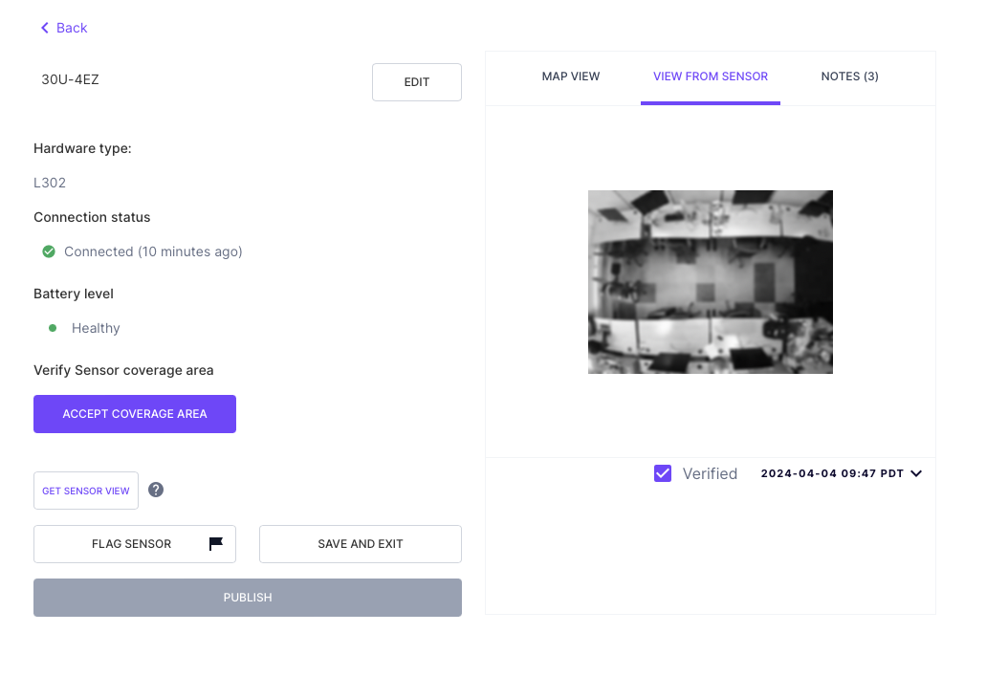
Sensor Installation
Confirming coverage
It may take up to 10 minutes after first connecting for the sensor debug image to update.
Debug file will also depend on how many sensors are already online in the mesh. The more are online, the faster they will connect.
If required to get a new image, click
‘Get sensor view’

Slide 30
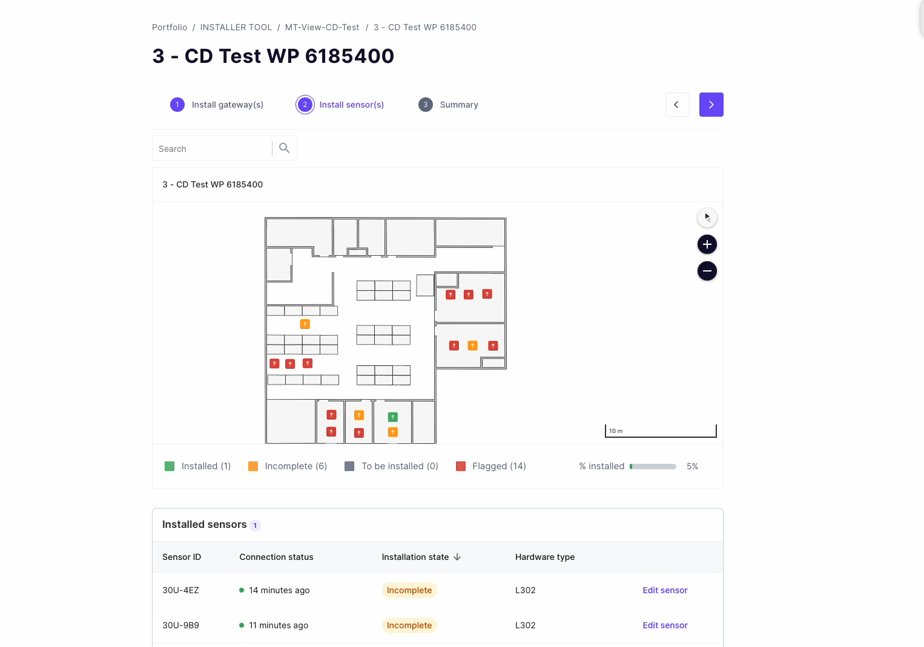
Sensor Installation
Confirming coverage
View coverage
Accept coverage
Publish sensor.
If coverage is not acceptable:
Adjust sensor
Request new image
Accept/Publish sensor

Slide 31
Sensor Installation - Tips
Best Practice
Turn sensor on for first time after it is installed in the ceiling
Do not block sensor with your hand or body
If you need a new debug image, request this from the installer tool.
You can power cycle by holding the power button for 2 seconds

Slide 32
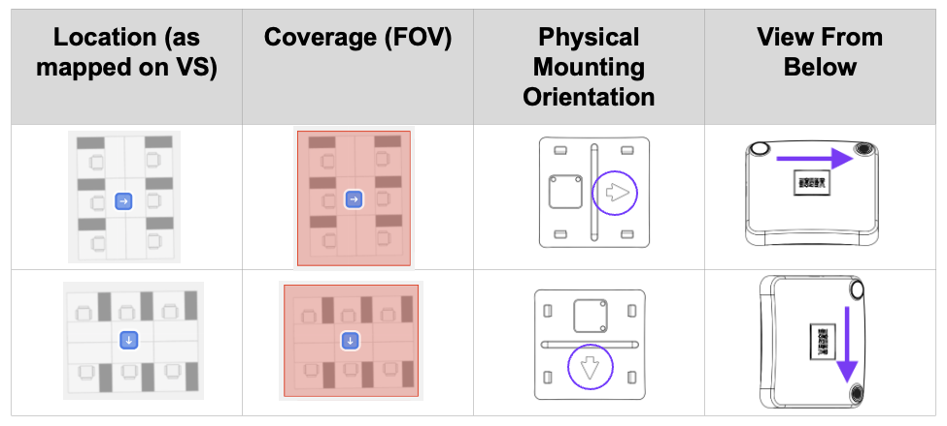
Sensor Installation
Orientation
Position the sensor to match the orientation indicated on the installation map

Slide 33
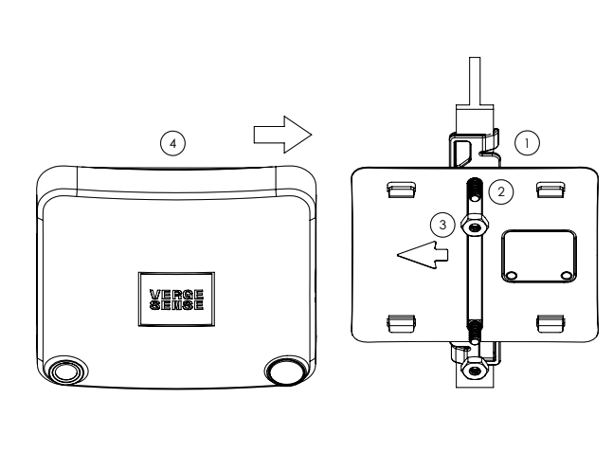
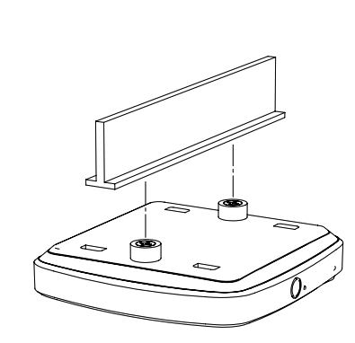
Sensor Installation
Clip hardware Magnet Hardware

Slide 34
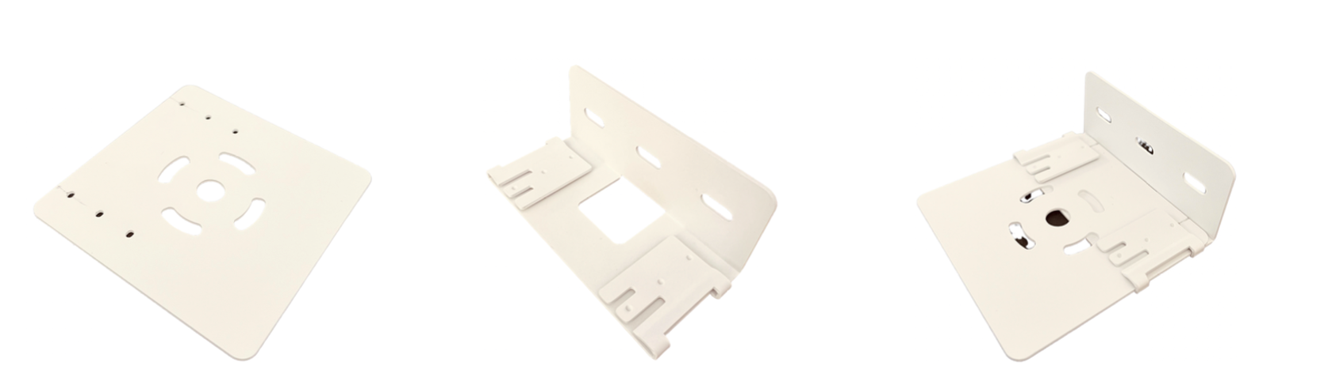
Sensor Installation
Universal Mount

Slide 35
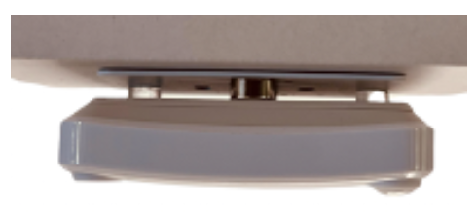
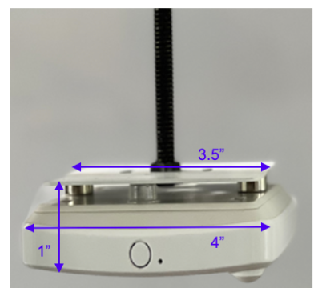
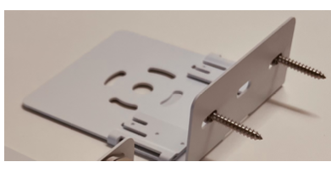
Sensor Installation
Universal Mount

Slide 36
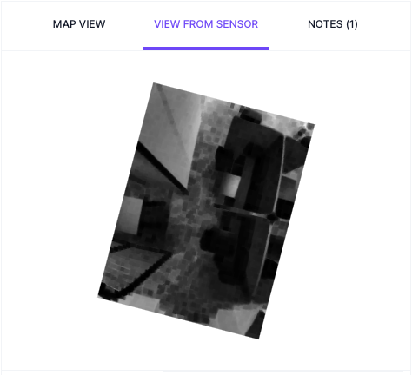
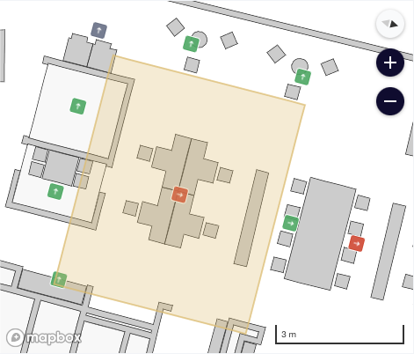
Sensor Installation – common mistakes

Slide 37
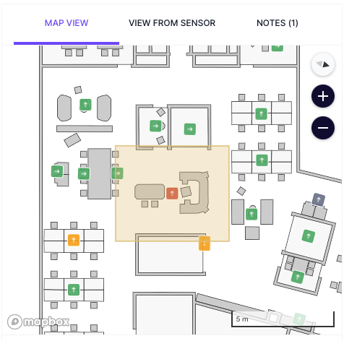
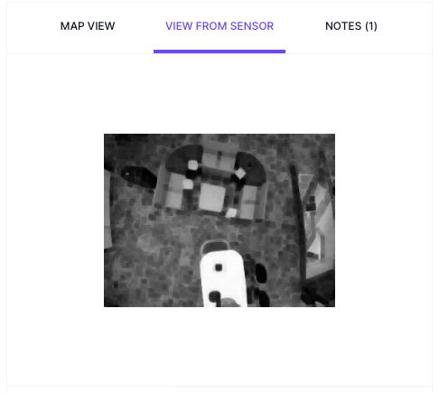
Sensor Installation – common mistakes

Slide 38
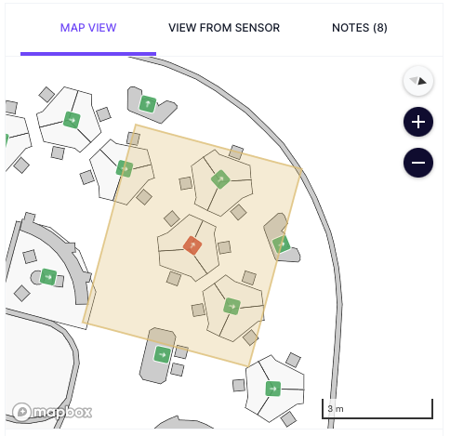
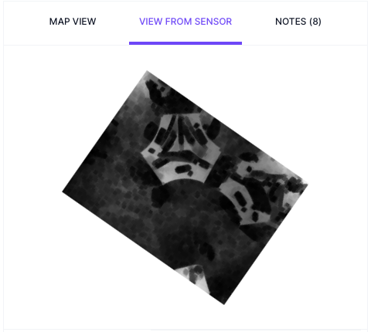
Sensor Installation – common mistakes

Slide 39
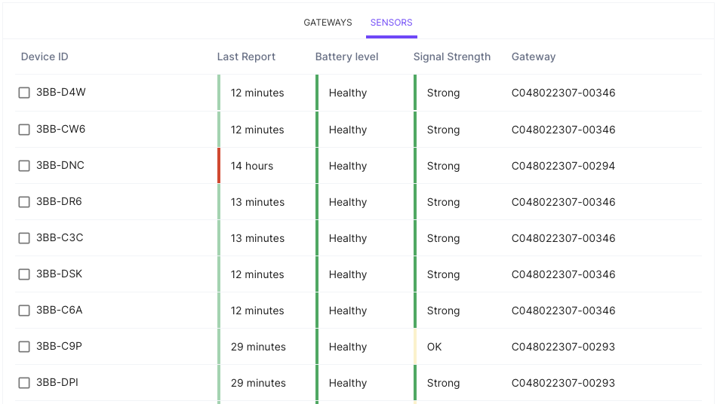
Sensor Installation – System Health
The System Health page gives a status overview of all gateways and sensors,
including the following information:
Gateways*
  Gateway heartbeat
  Last sensor report timestamp
  Uptime
Sensors
  Device ID
  Last Report timestamp
  Battery level
  Signal strength
  ID of gateway sensor is connected to

Slide 40
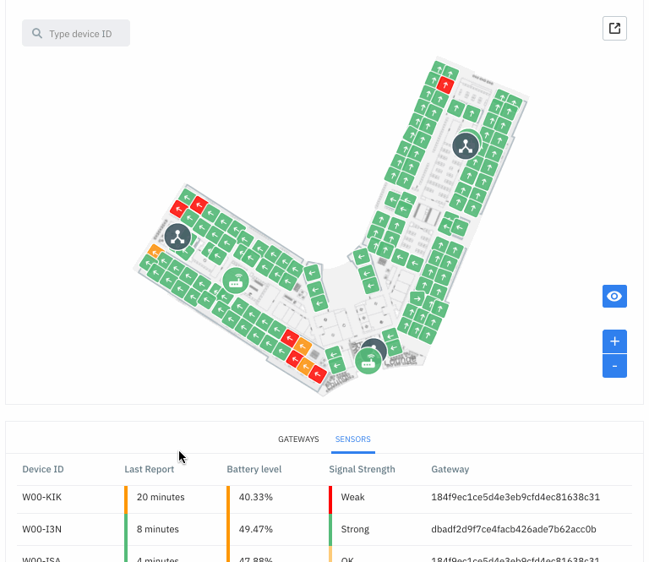
Sensor Installation – System Health
After all devices have been installed on a floor, navigate to the System Health page.
Green = Good
Red/Yellow = Needs attention (e.g. weak signal strength)
Black = Never connected (verify ID/power)

Slide 41
Installation - Troubleshooting
If gateway does not connect
Confirm ID
Check and tighten all connections (antennas, power)
Power cycle
If still not connecting, contact VergeSense support
If sensor does not connect
Confirm ID
Confirm power
Power cycle
Replace sensor
If still not connecting, contact VergeSense support

Slide 42
Team Structure and
Deployment Timeline

Slide 43
Team Structure and Deployment Timeline
Two person team
Three person team
Each Tech
Ceiling Installation
Check coverage and make adjustments
Checkout
(Cleanup, etc)
Setup
Pre-place sensor at ground level, enter sensor IDs
Ceiling Installation
(if time)
Check coverage and make adjustments
Tech 1
(Lead)
Ceiling Installation
(on ladder)
Tech 2 & 3
Setup
Checkout (Cleanup, etc)

Slide 44
Team Structure and Deployment Timeline
1 hour
Setup
6 hours
Installation
(45 magnet sensors)
1 hour
Cleanup
Coverage
Check
Send
Summary

Slide 45

Live Support
VergeSense will be available to support live.
Preferred method of communication is WhatsApp.
Please share contact info to setup a group chat.

Slide 46
Questions?

Slide 47
Thank you

