Slide 1
VergeSense Installation
EN-1 overview
David Whiley
V2.0 March 2025

Slide 2
Agenda
01
02
03
04
05
06
07
Introduction
Hardware
Installer tool
Process Overview
Installation Steps
Team Structure and Deployment Timeline
Q&A

Slide 3

Introductions
David Whiley
Implementation Specialist

Slide 4
Hardware

Slide 5
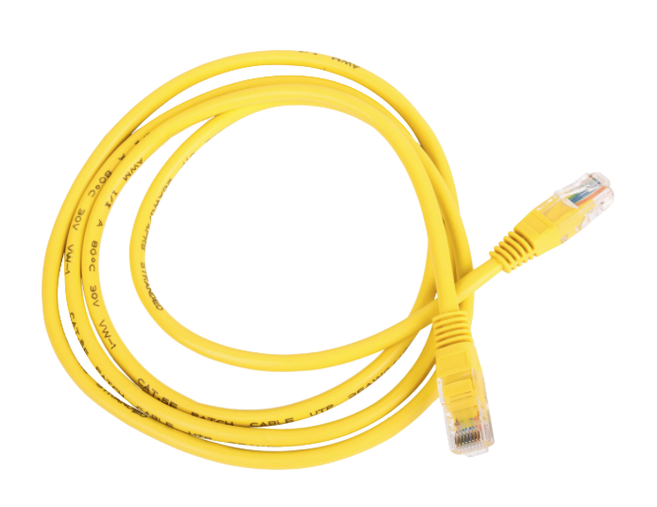
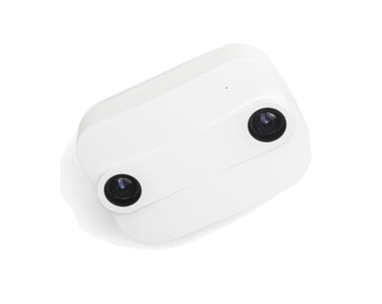
What is being installed?
EN-1 sensor
Size:
3.8” (98mm) (L)
3.8” 98 mm (W)
1.1” (28 mm) (H)
Cat 5/6 PoE Class 0
1 per device

Slide 6
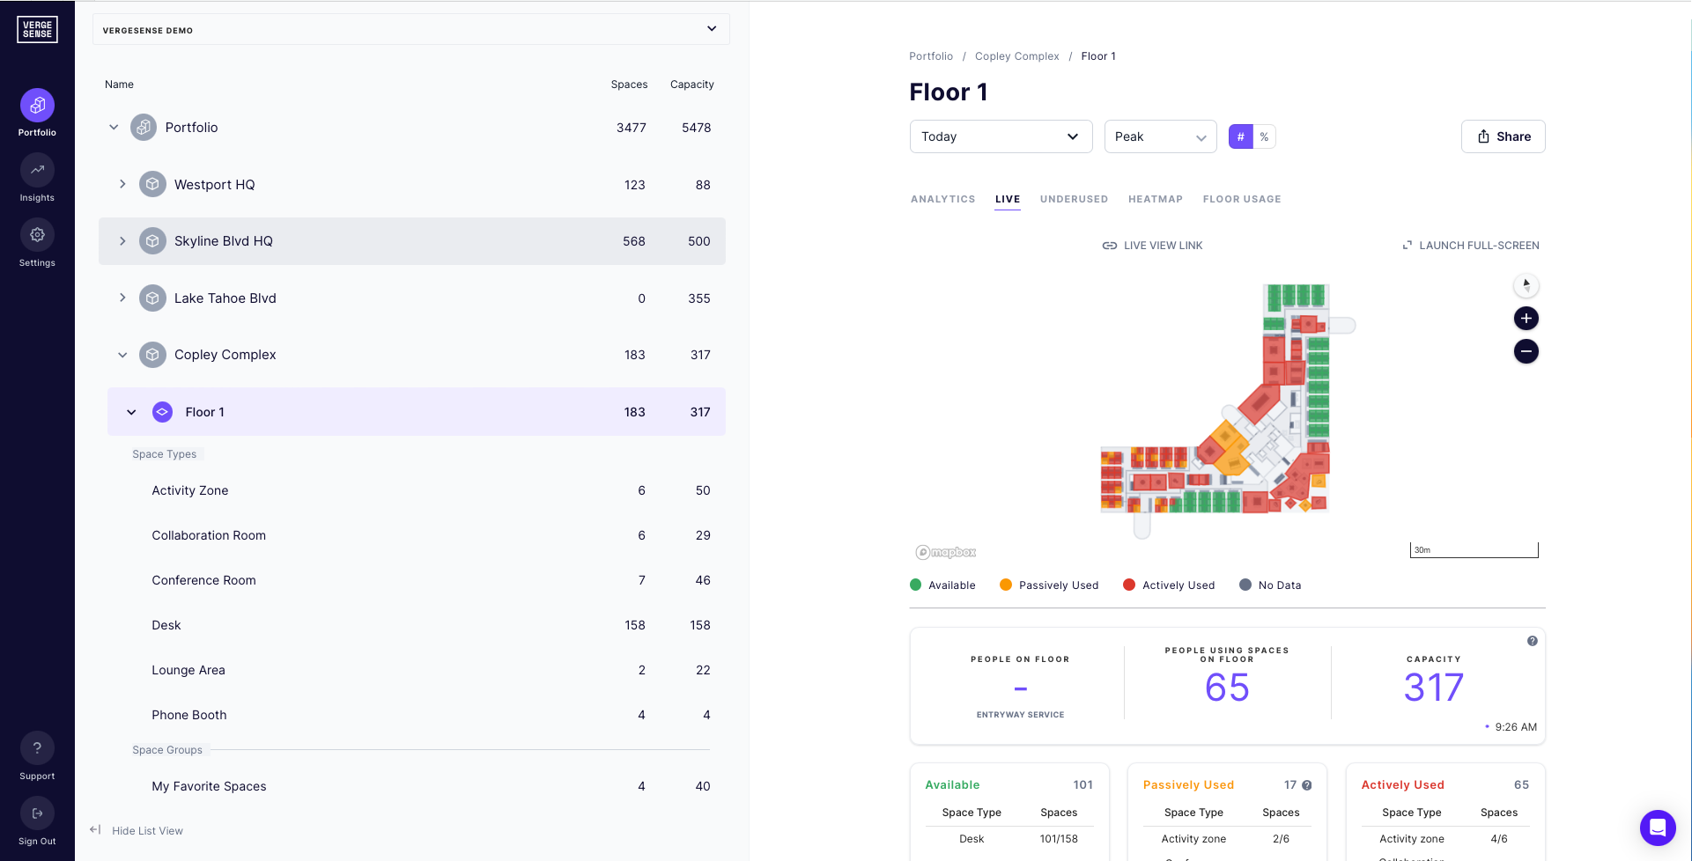
How it connects
Corporate Network

Slide 7
Installer tool

Slide 8
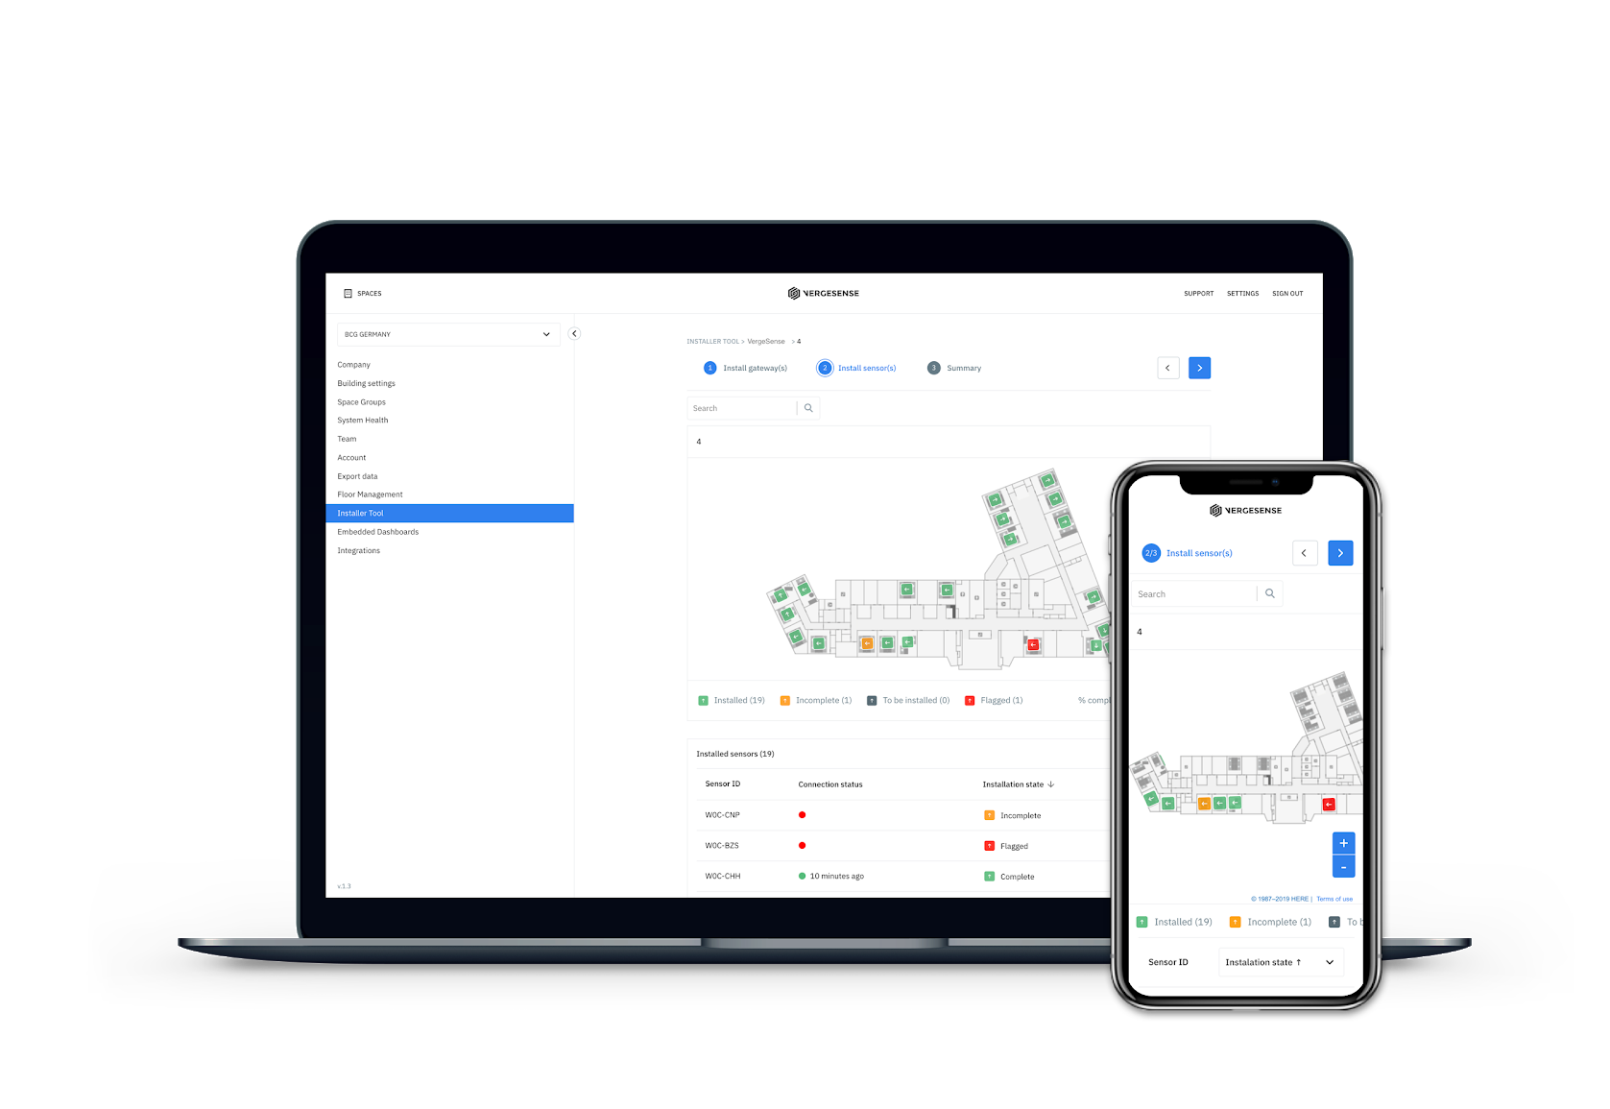
VergeSense - Installer tool
The VergeSense Installer Tool application can be used to:
Advises where the hardware is to be installed
Check Sensor connectivity
Track installation progress
VergeSense will grant access to the installer tool prior to start of installation.
Access the web based application at
cloud.vergesense.com

Slide 9
EN-1 Xovis - Installer tool
The VergeSense Installer Tool application can be used to:
Check sensor connectivity
Confirm sensor coverage
Commission sensor
Test
VergeSense will grant access to the installer tool prior to start of installation.
Access the web based application at
vergesense.xovis.cloud

Slide 10
Process Overview

Slide 11
Installation Process Overview
Installation Team
VergeSense
Install
Sensors
Confirm Connectivity
& Coverage
VergeSense Implementation Support
Remotely / Onsite

Slide 12
Installation Process Overview
VergeSense (Small installations)
VergeSense will review & flag sensors
Reporting back to the installation team the SAME DAY for adjustment
VergeSense (Larger installations)
VergeSense will review & flag sensors
Reporting back to the installation team a report for Go Back remedial works

Slide 13
Installation Process Overview
Installation Team
VergeSense
Review flagged
Sensors
Adjust Sensors &
Clear flags
(Adding notes if required)
Confirm Connectivity
& Coverage
VergeSense Implementation Support
Remotely / Onsite

Slide 14
Installation order - #1
Physical installation
Run cabling for sensor. Leave some slack for adjustments of sensor location if needed.
Use VergeSense Installer tool
To check the location of where the sensor is to be installed.

Slide 15
Installation order - #2
Physical installation of sensors
Install sensor as per the Installer tool floor plan
Install in the orientation shown
Power on
Use VergeSense Installer tool to:
Enter ID of sensor installed
Check Connectivity
Use EN-1 Xovis Installer tool to:
Check connectivity
Confirm coverage
Test sensor

Slide 16
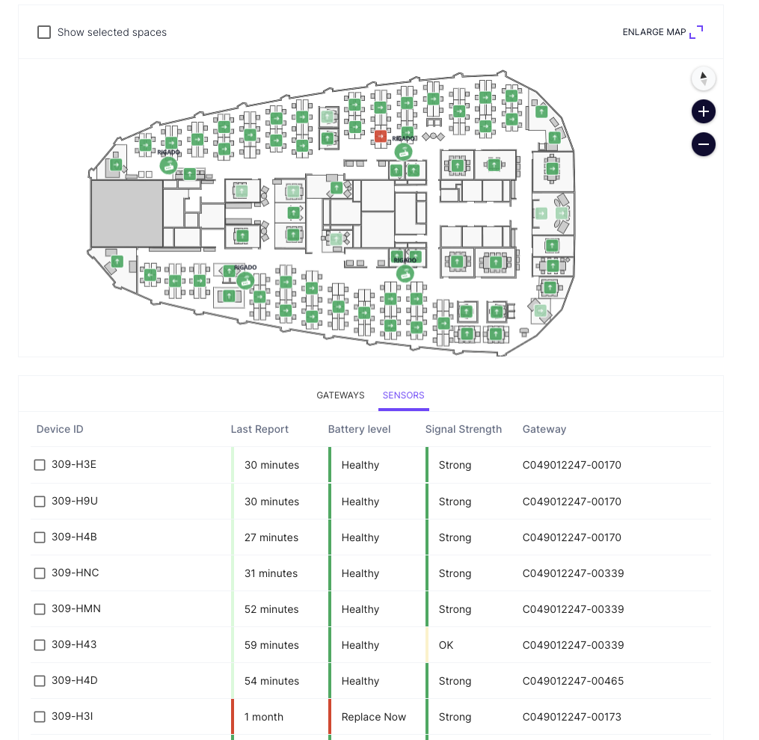
Installation order - #3
Check connectivity
Navigate to the System Health Page
Review status of all Sensors
Troubleshoot if needed

Slide 17
Installation Steps

Slide 18
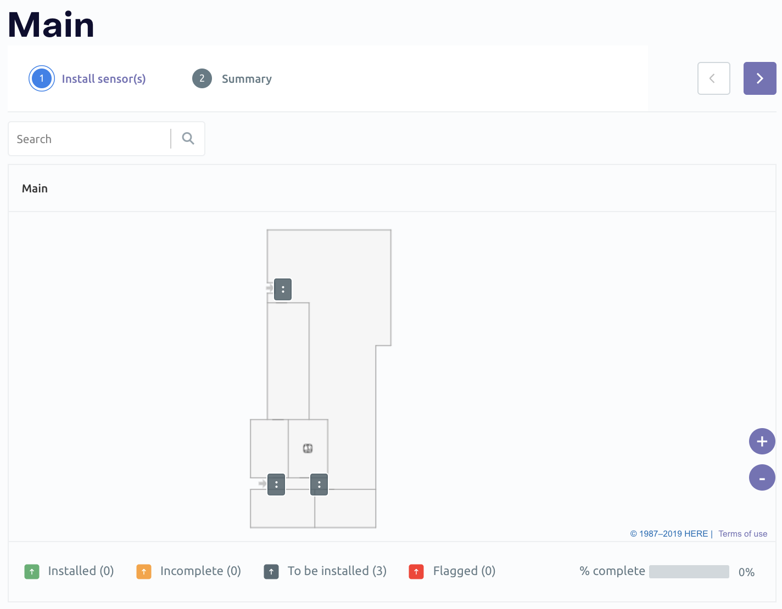
Sensor Installation
Locate where the sensor needs to be installed
Open the installer tool
Select the floor of installation
On the second step, you are presented with all the sensor icons of where they are to be installed (grey)

Slide 19
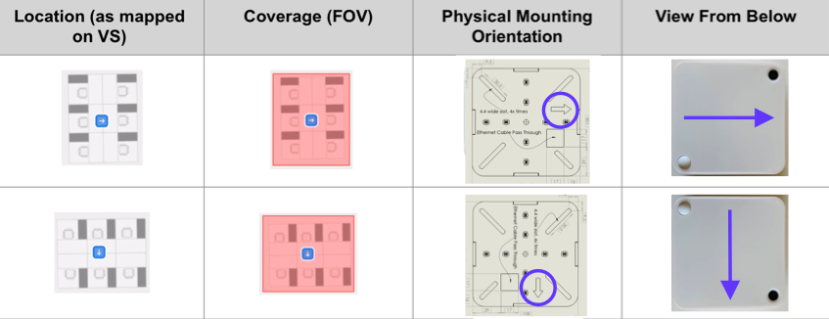
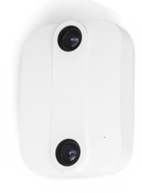


Sensor Installation
Orientation
Position the sensor to match the orientation indicated on the installation map

Slide 20
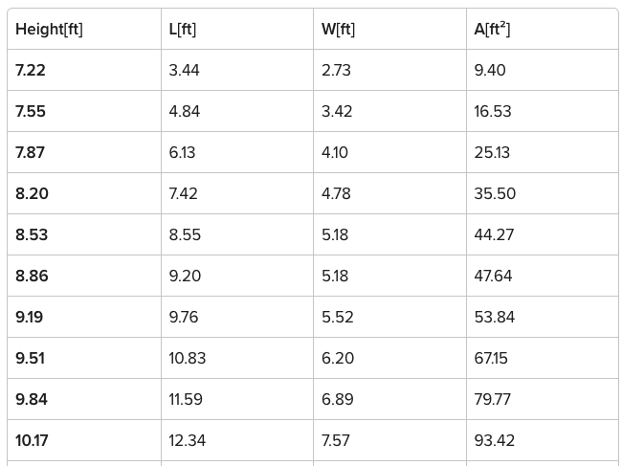
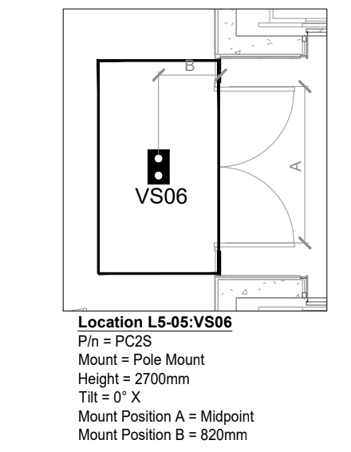
Sensor Installation
Installation Height: Able to install 7.22’ – 19’
Coverage area will be determined based on the height.
Obstructions: Obstacles hanging from the ceiling (signs, air conditioner, lamps or decoration, etc.) may limit the sensors coverage area. Using the obstruction calculator tool, determine the modified coverage area of the sensor.
Position: Mounted away from door. Recommended that the sensor is 3’ away from the doorway.

Slide 21
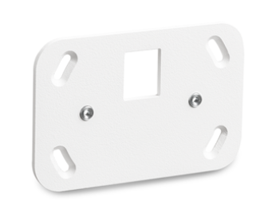
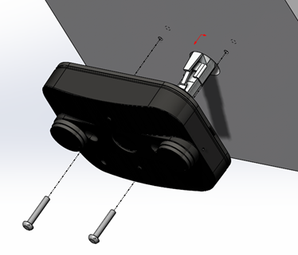
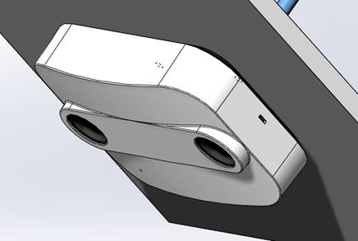
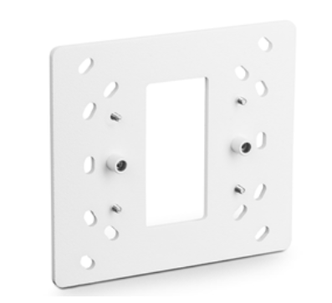
Sensor Installation
Optional Mounts
Pull the Ethernet cable through the hole in the ceiling and plug-in the sensor.
Fit the EN-1 sensor onto the ceiling and use the two included M4 screws to fix the sensor
Remove the dust-caps from the sensor lenses. And click the cover on the sensor.
Small Mount
(Rough-in work)
Drop Pole Mounting Adapter
(J-box on. Pole)

Slide 22
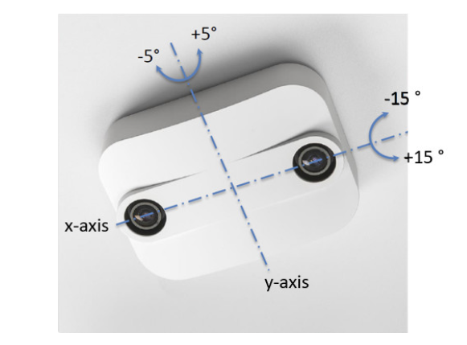
Sensor Installation
Mounting tilt
Please note that the sensor will detect any tilt, we understand not every surface is perfectly 0 degrees.
Our sensor supports a tilt of max. +5°/-5° in the Y-axis and max. +15°/-15° in the X-axis only. Nevertheless, we generally don’t recommend tilting the sensor.

Slide 23
Configuration tool for EN-1 - Xovis
What will this be used for?
To check that the sensor is connected and online
Configure the sensor setup
  Set the floor configuration
  Date/Time settings
  Sensor installation height
  Callibrate the sensor
Configure how the sensor is going to count people
  E.g which direction will count people on the floor/space
  Test if the counting it working correctly

Slide 24
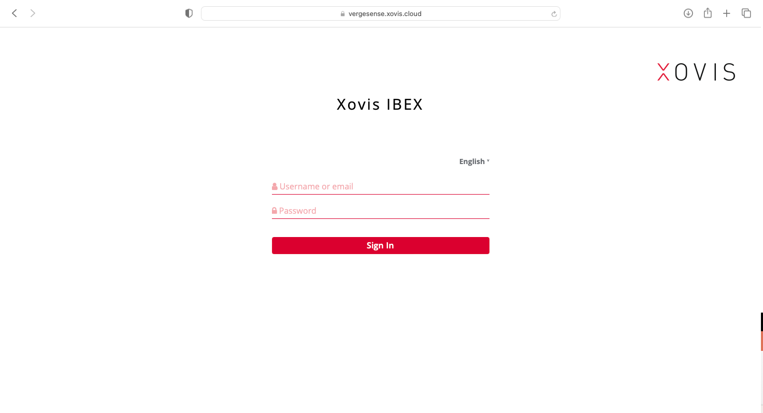
Configuration for EN-1
Login to the EN-1 configuration/commissioning tool
https://vergesense.xovis.cloud
You will be granted access
Select the customer on the left hand side
Choose ”Device Control”

Slide 25
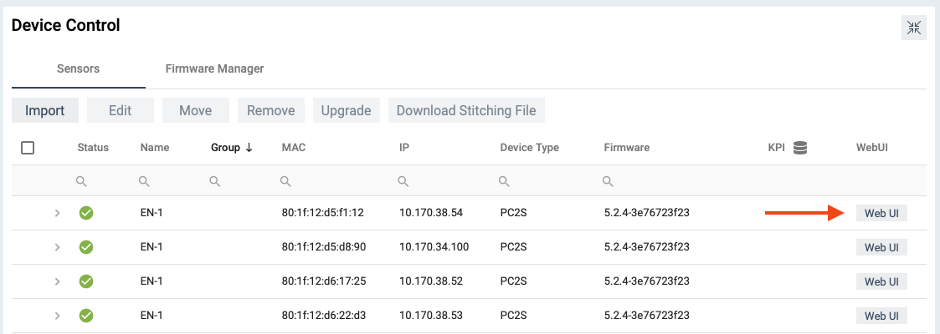
Configuration for EN-1
Locate sensor
You will be presented a list of all sensors for this installation.
Status Green tick – Online
Status Red cross – offline
Select the sensor you have installed by confirming
The MAC address.
Click Web UI to launch configuration for that sensor.

Slide 26
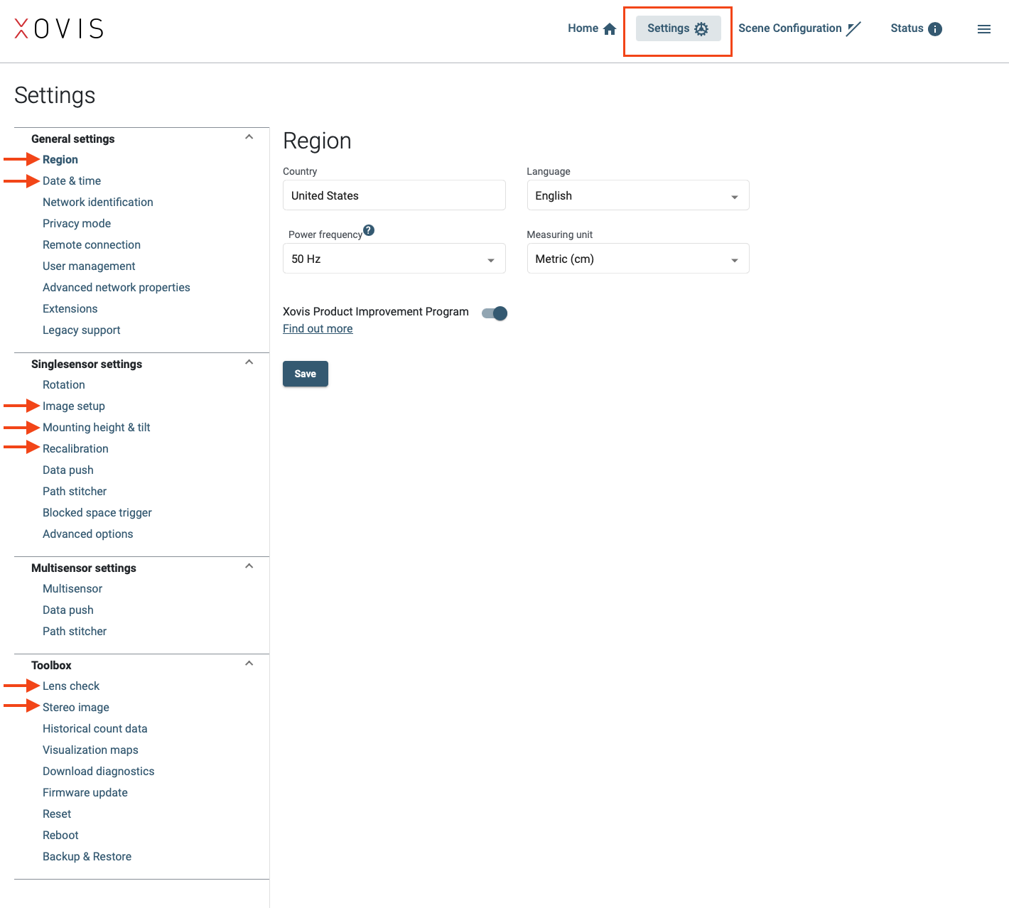
Configuration for EN-1
Start configuration
Once logged into the specified sensor you can skip the installation wizard.
Click settings at the top
Here is the required settings we need to be populated.

Slide 27
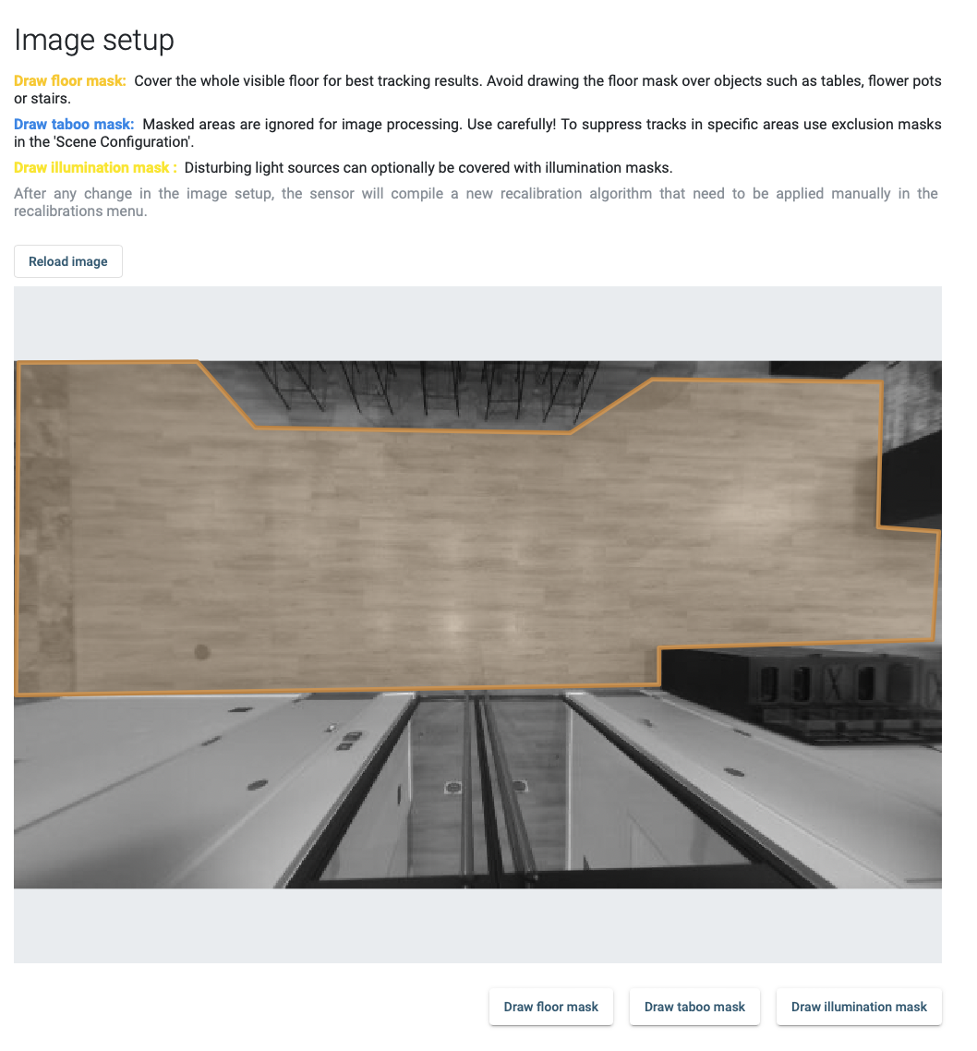
Configuration for EN-1
Image Setup
Reload Image
Draw floor mask
Tip: When drawing the floor, avoid all items like tables/chairs/bins etc. Just the floor to be captured.

Slide 28
Configuration for EN-1
Mounting height & tilt
Sensor mounting height
Tilt setup - Automatic
Tip:
Please note that the sensor will detect any tilt, we understand not every surface is perfectly 0 degrees.
Our sensor supports a tilt of max. +5°/-5° in the Y-axis and max. +15°/-15° in the X-axis only. Anything that detects over these values, please adjust the sensor.

Slide 29
Configuration for EN-1
Recalibration
New recalibration can be applied - Apply

Slide 30
Configuration for EN-1 - checks
Toolbox
Lens check – make sure clean and no obstructions
Stereo check.
Tip
For stereo check. Dark blue is what the sensor can detect as the floor. If this looks right then continue, if not check the image setup step.

Slide 31
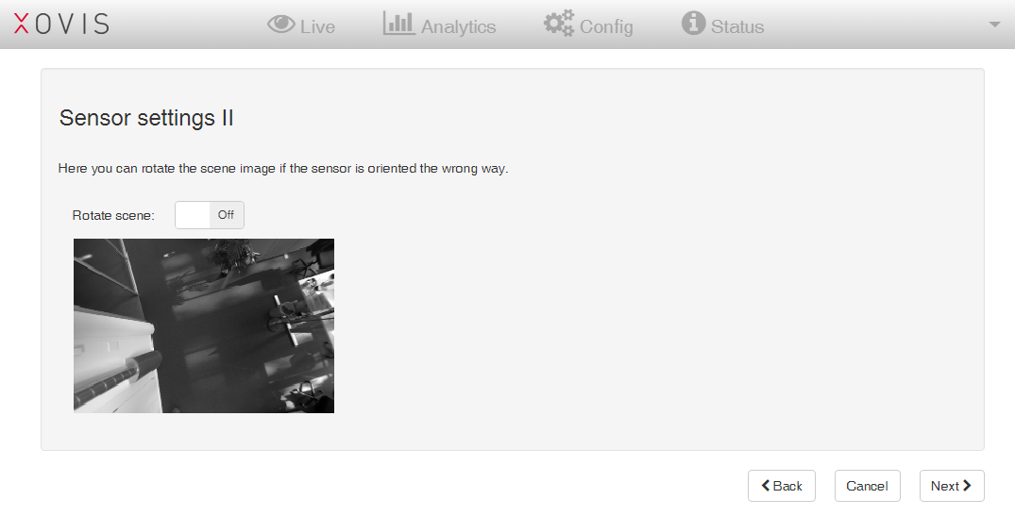
EN-1 Tool - Commissioning
Sensor Settings
Network
Sensor Name
Mounting height
Person size
Notes:
The first steps will guide you through calibrating a few settings such as network, sensor name, mounting height, person size. This does require a technician onsite to interact with the sensor

Slide 32
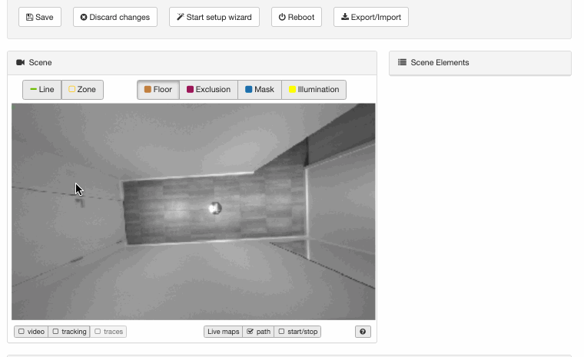
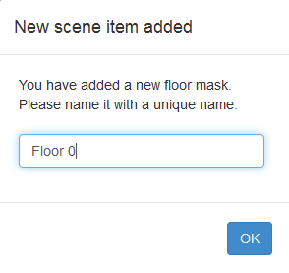
EN-1 Tool - Commissioning
Marking the floor
A masked area on the floor will indicate the space the sensor will capture
Exclude walls and furniture
The floor is marked or masked by selecting the drawing tool “Floor” and directly drawing the whole floor as a polygon in the scene
Notes:
Next you will be asked to mark the floor. Marking the floor will indicate the space in which the sensor will capture data. Be sure to exclude any walls or furniture. This marking, or masking, is done by selecting the drawing tool “Floor” and directly drawing the floor as a polygon in the image.

Slide 33
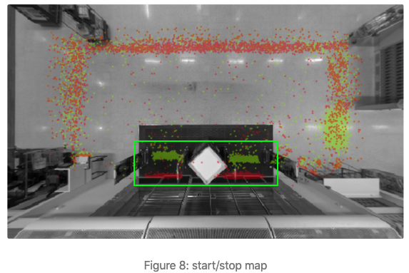
EN-1 Tool - Commissioning
Setup Count Lines
The red and green dots within the green box represent the entryway's entry/exit points (known as start/stop points)
The count line should be behind the highest concentration of start/stop points.
Notes:
The red & green dots within the green box in this image represent the entryway’s entry and exit points (also known as start and stop points). The count line should be behind the highest concentration of these start and stop points.

Slide 34
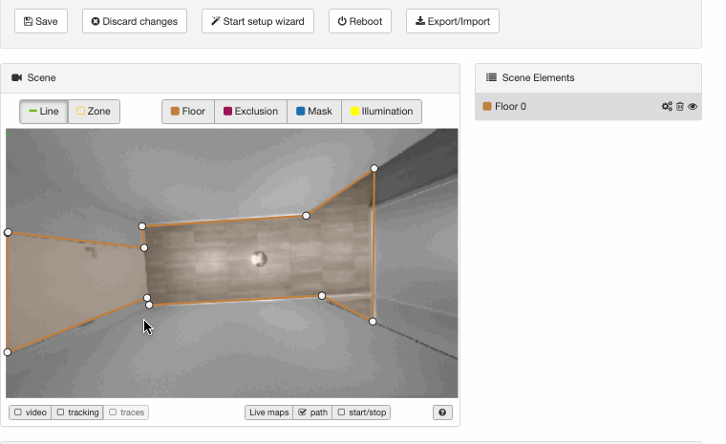
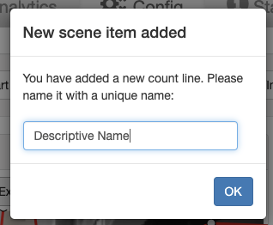

EN-1 Tool - Commissioning
Setup Count Lines
Person walking across the line will be counted
The green arrow indicates the direction
When naming: as a rule of thumb, use the forward orientation of the green arrow to point to the space of interest.
E.g. “Forward-Lobby West Entrance” or "Forward-restroom".
Notes:
The countline is the threshold that when crossed will update the person count for the space. As shown in the previous slide, the count line needs to be drawn so it can capture the highest start/stop points. It’s important for the user that is commissioning to understand the space and name the line accordingly (for example “Forward - Lobby West Entrance” or “Forward - Restroom”). As a rule of them when naming the count line use the forward orientation of the green arrow to point to the space of interest.

Slide 35
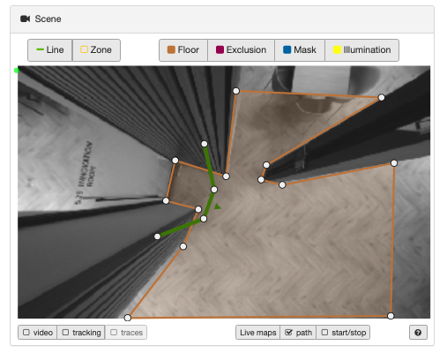
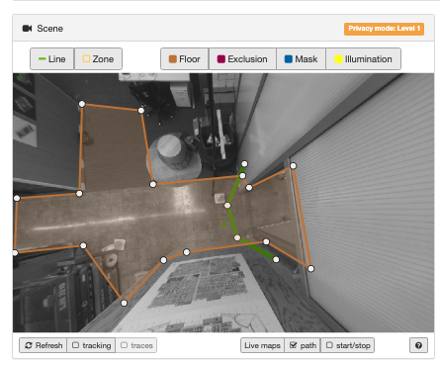
EN-1 Tool - Commissioning
Notes:
Here are a few more common examples of countlines

Slide 36
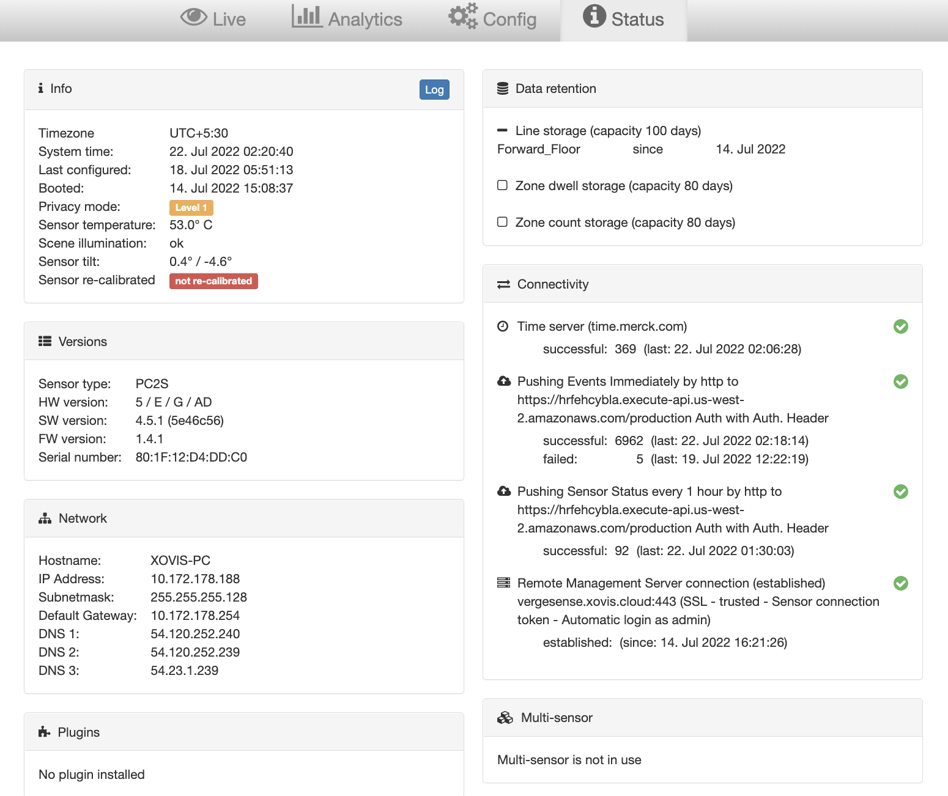
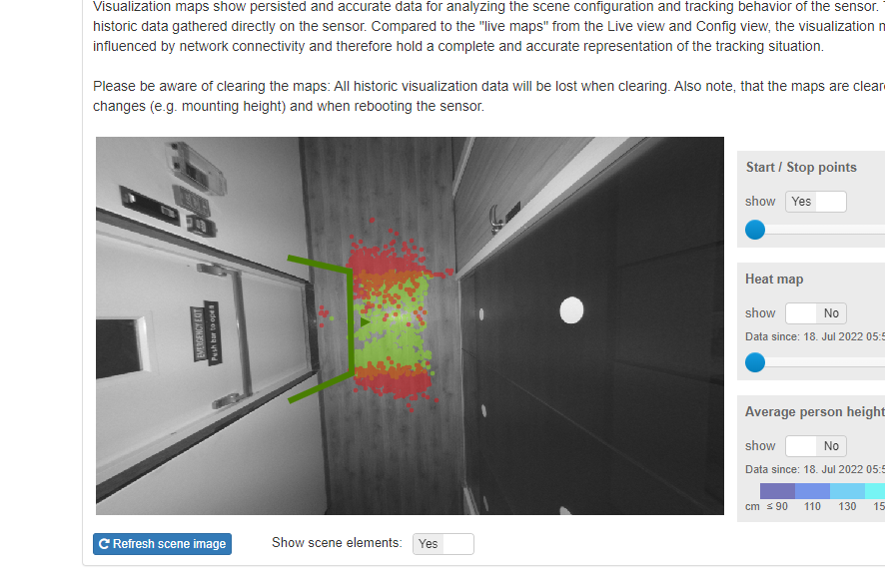
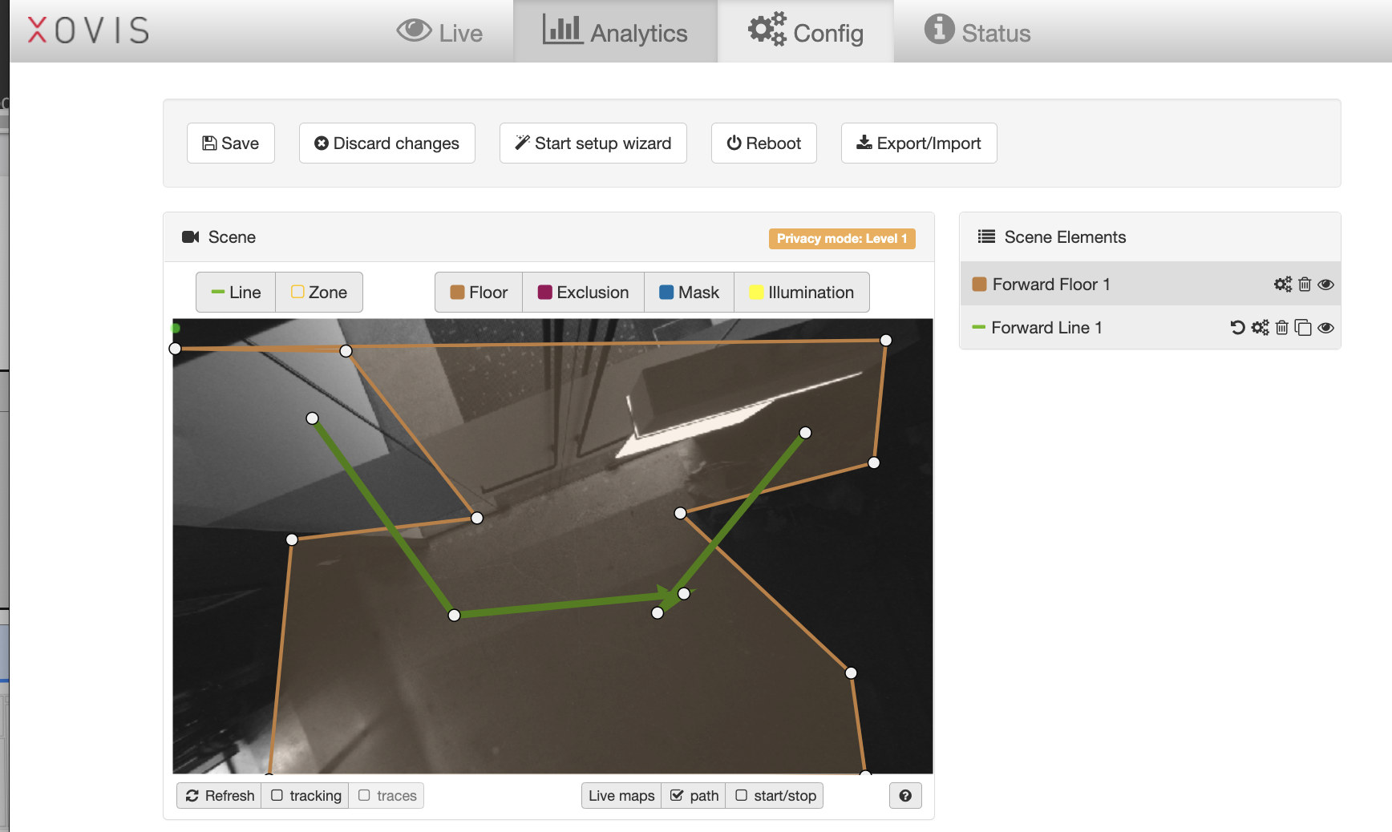
EN1 Commissioning- What Not To Do
Sensor must always be calibrated
Floor mask must be created
calibration and commissioning needs to happen when sensor is in final position

Slide 37

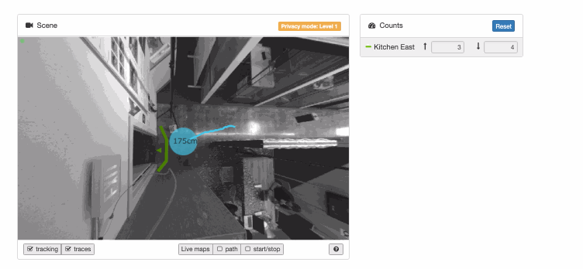
EN-1 Tool- Testing
Test Count Lines
After the setup wizard is completed the Live View will load
To test the sensor, walk across the count line. The start/stop count will update.
Recommended to cross threshold 50 times with accuracy of 95%.
Notes:
In this view- the colored circle represents an occupant. The user will then cross the threshold, and view the counter to confirm accuracy. This test takes about 5 minutes for a single person to do. It is recommended to cross the threshold 50 times with accuracy of 95%.

Slide 38
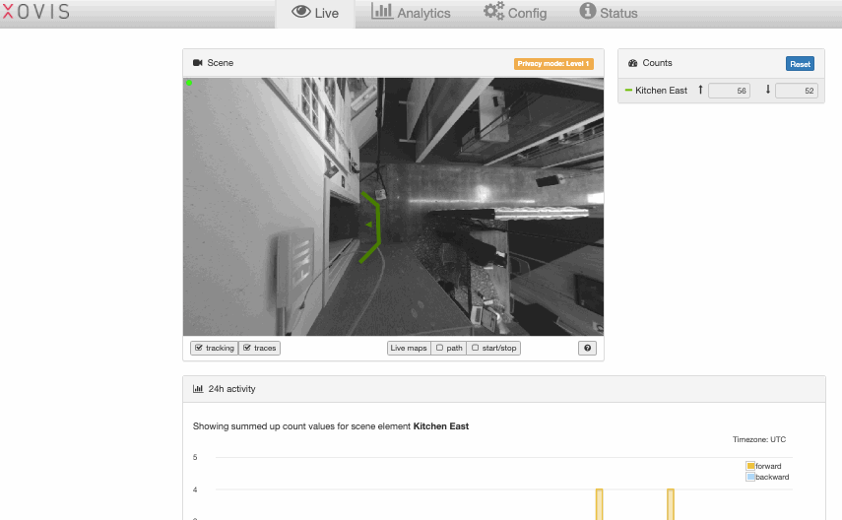
EN-1 Tool- Testing
You can also verify the accuracy of the count line by viewing the start/stop map under Analytics. The count line should be behind the start / stop points as shown below.
Notes:
The accuracy of a count line can also be verified by viewing the start/stop map under Analytics in the entryway installer tool. The count line should be beind the start & stop points as shown on this slide.

Slide 39
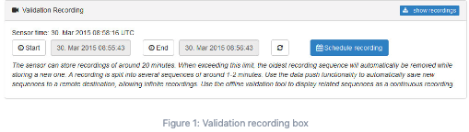
Validation Recording
Xovis>Live> Schedule Recording
The validation recording box allows you to manage the sensor's validation recordings. A validation recording contains the scene video, person tracks, the count item configuration and all line counting and crossing events. With this information, the sensor's functionality can be easily verified.

Slide 40
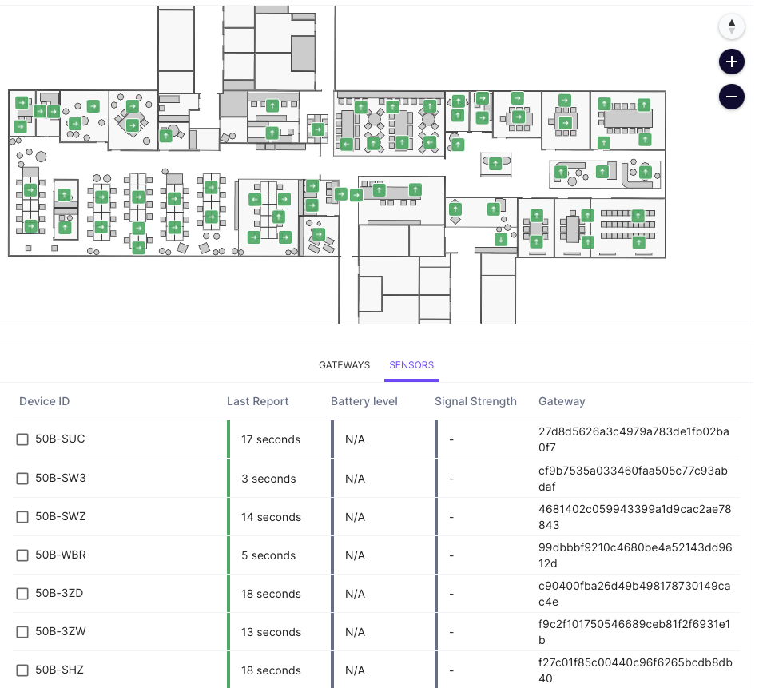
Sensor Installation – System Health
The System Health page gives a status overview of all Sensors.
including the following information:
Sensors
  Device ID
  Last Report timestamp

Slide 41
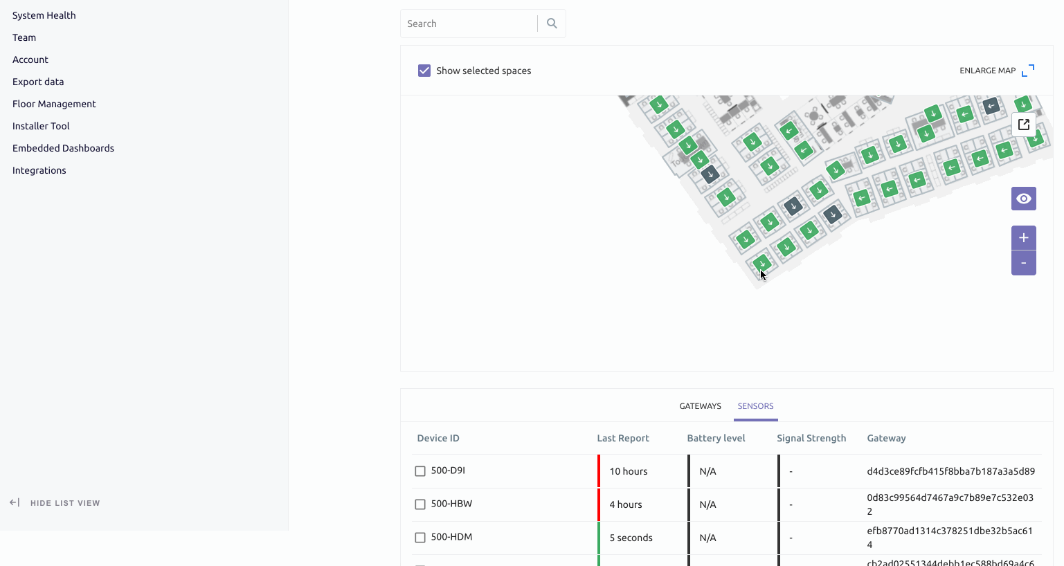
Sensor Installation – System Health
After all devices have been installed on a floor, navigate to the System Health page.
Green = Good
Red/Yellow = Needs attention (e.g. disconnected)
Black = Never connected (verify ID/power)

Slide 42
Installation - Troubleshooting
If sensor does not connect
Confirm ID
Confirm power
Power cycle
Replace sensor
If still not connecting, contact VergeSense support

Slide 43
Team Structure and
Deployment Timeline

Slide 44
Team Structure and Deployment Timeline
Two person team
Three person team
Each Tech
Ceiling Installation
Check coverage and make adjustments
Checkout
(Cleanup, etc)
Setup
Pre-place sensor at ground level, enter sensor IDs
Ceiling Installation
(if time)
Check coverage and make adjustments
Tech 1
(Lead)
Ceiling Installation
(on ladder)
Tech 2 & 3
Setup
Checkout (Cleanup, etc)

Slide 45
Team Structure and Deployment Timeline
1 hour
Setup
6 hours
Installation
(6 sensors)
1 hour
Cleanup
Coverage
Check
Send
Summary

Slide 46

Live Support
VergeSense will be available to support live.
Preferred method of communication is WhatsApp.
Please share contact info to setup a group chat.

Slide 47
Questions?

Slide 48
Thank you

